Slide 1
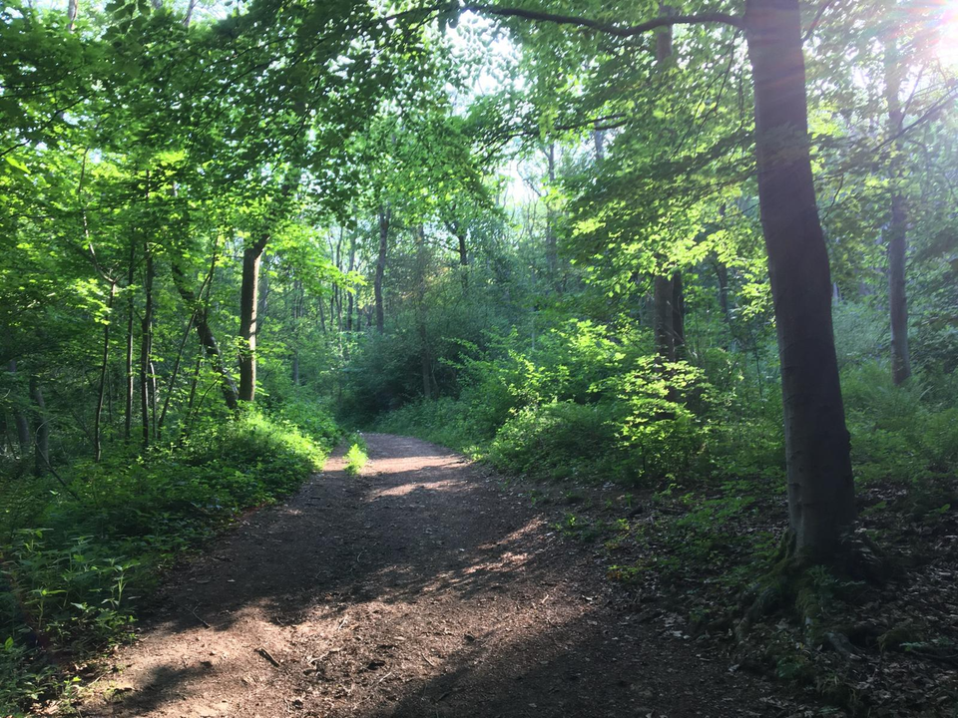
Climate and Nature Partnership
21st July 2026
  Please grab a drink and be seated by 1pm
12.30pm Arrival and tea/coffee/chat
1.00pm Welcome (Shalize Nicholas, Chair)
1.10pm Soil Health Strategy (Rebecca Charley, Stroud District Council)
1.20pm Gloucestershire’s Master Composters (Karen Phimister, Garden Organic)
1.30pm Bisley Community Composting Scheme (Trustees)
1.40pm Partnership Opportunities (small group discussion) and feedback
2.10pm break
2.20pm Waste Engagement Plan (Kelly Osbourne, Gloucestershire County Council)
2.30pm Gloucestershire Waste and Recycling partnership (Cllr Tricia Watson, SDC)
2.40pm Emergence Restock and other local repair partners (Shalize Nicholas, Emergence Restock)
2.50pm Partnership Opportunities and feedback
3.10pm Partner Updates
3.25pm Thanks and Close
3.30pm Feel free to stay on and mingle for a while

Slide 2
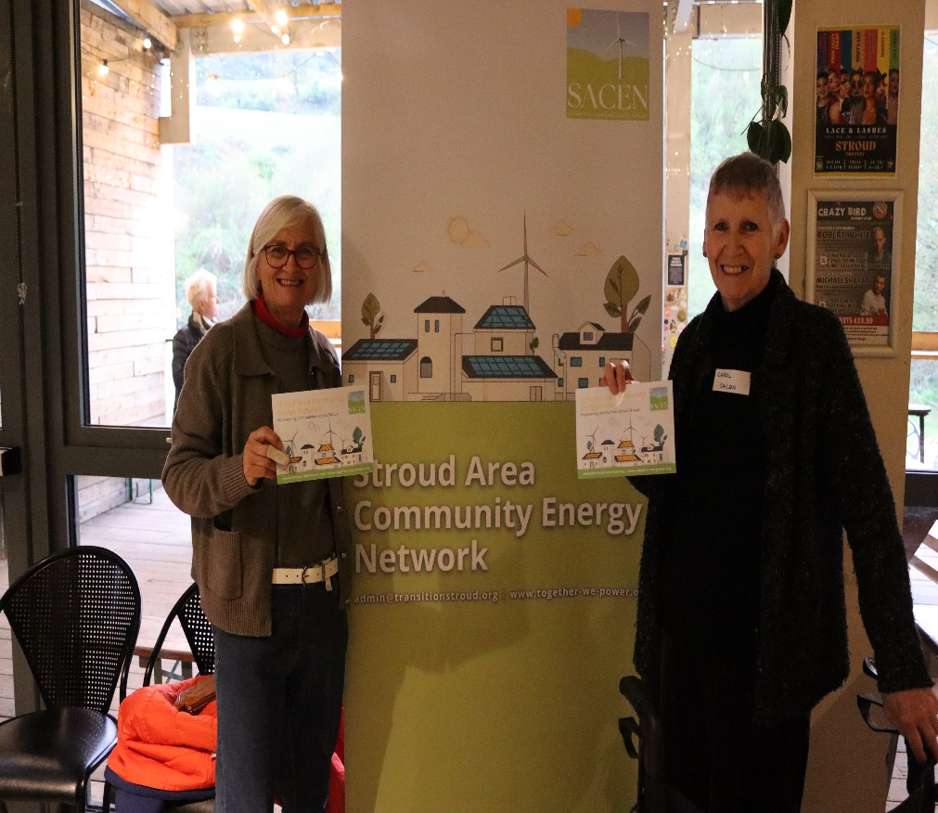
Welcome
  Housekeeping (fire alarms, loos, photographs)
  Please use the microphones when speaking to the whole group
  Today’s voted theme is:
  Promoting and encouraging reuse, refill and repair across the district and enabling private and community composting schemes
  Tight agenda – discussion and feedback opportunities have been scheduled

Slide 3
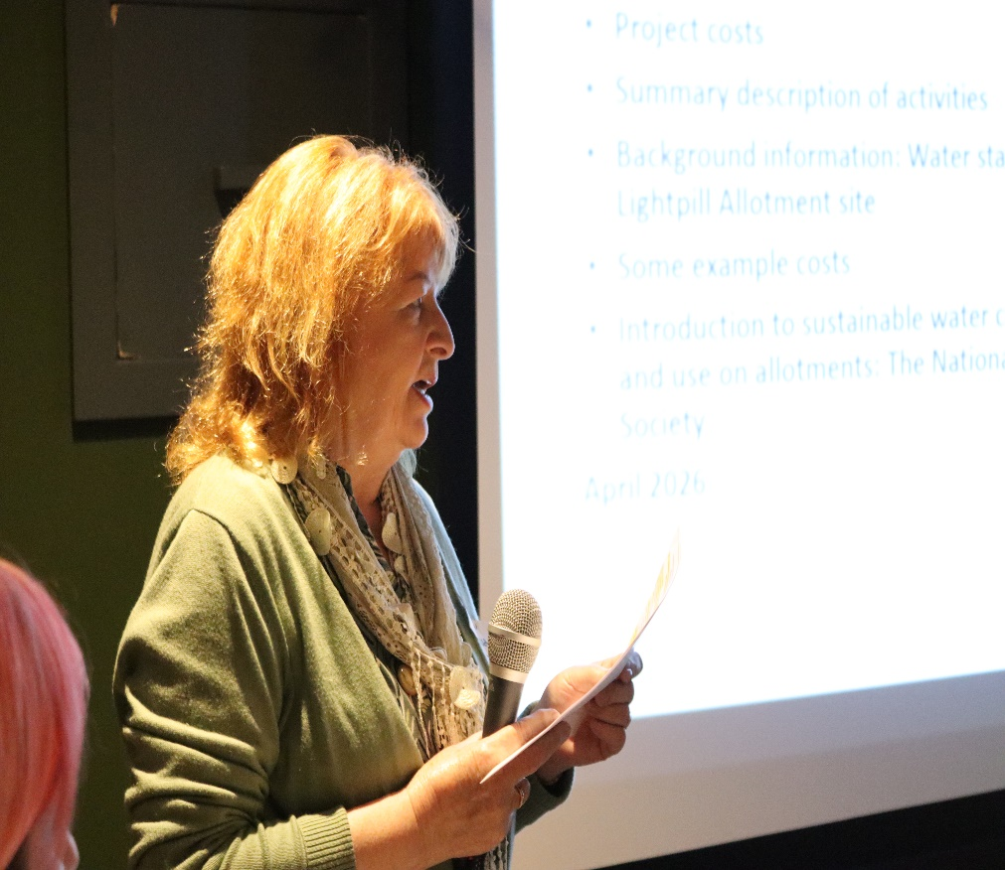
Welcome cont…
  The Climate and Nature partnership (the partnership) meets quarterly
  Stroud district council acts as secretariat
  The partnership:
    Is open to all organisations
    Will showcase best practice on themes and invite discussion
    Will facilitate networking, collaboration, and record voluntary action taken by partners
    Shares information about funding opportunities
  The partnership is not:
    Owned by Stroud district council
    A democratic committee of stroud district council
    A forum with a budget to implement actions

Slide 4
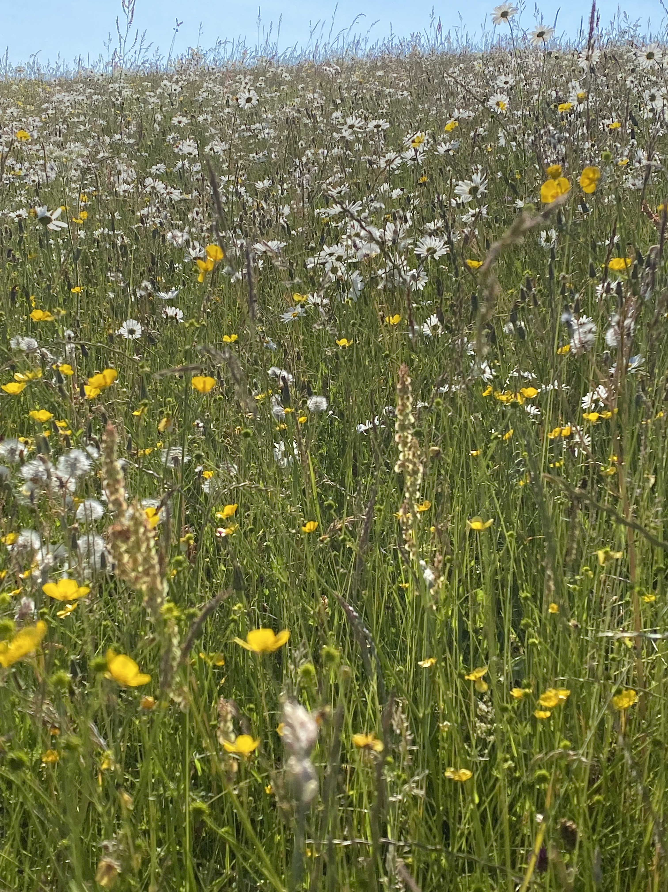
Healthy Soils: Climate, Nature and Gloucestershire
Rebecca Charley
Why is soil important to all of us?
Notes:
Introduce soil health as a foundation for climate resilience, nature recovery and sustainable food systems in Gloucestershire.

Slide 5
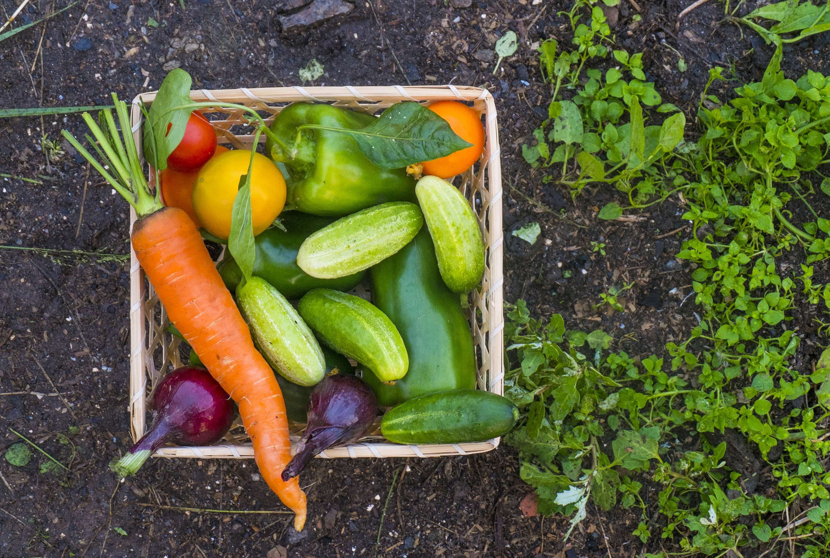
Why Soil Health Matters
Climate benefits
  Stores carbon, helps build resilience
  regulates water,
Nature benefits
  Biodiversity and ecosystem recovery
Health benefits
  supports nutrient dense food production
Notes:
Healthy soils store carbon, regulate water, support productivity and underpin ecosystem services.
Soils contain more carbon than the atmosphere and vegetation combined. Improving soil organic matter is a practical climate action.
Soil biodiversity supports nutrient cycling, pollination, habitat quality and ecosystem resilience.
Healthy soils can produce food with a higher nutrient density, giving the consumer a more nutritious product

Slide 6
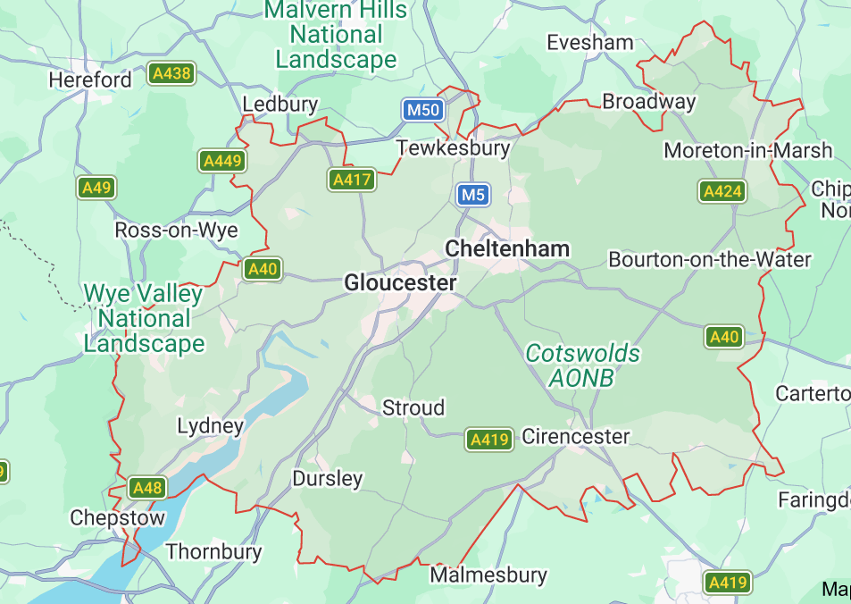
Local Context
Gloucestershire wide
  LNRS and nature recovery priorities
Stroud context example
  Stroud Landscape Project restoring species-rich grasslands
Notes:
The Gloucestershire Local Nature Recovery Strategy has identified opportunities for joined-up habitat networks across the county. In relation to soils its focus is:
Soil Protection and Carbon Sequestration: The strategy integrates soil protection as a key nature-based solution to mitigate climate change and fix carbon.
Preventing Soil Degradation: The LNRS targets poor agricultural practices, advocating for cover crops and soil restoration to avoid leaving fields bare during the winter.
Habitat Suitability: The strategy's spatial mapping highlights that habitat creation (such as ponds or floodplain meadows) relies heavily on specific soil conditions (e.g., whether the land is free-draining, compacted, or permanently wet) to ensure the actions succeed.
Specific Soil Geologies: Distinct local soil types, such as the thin skeletal soils required by endangered species (e.g., mosses), and calcareous soils, dictate exactly which measures (such as calcareous grassland management) should be implemented.
Stroud Landscape Project is an example of restoring species-rich grasslands, wildlife corridors and nature recovery at landscape scale, which in turn protects and enhances the soils life that surrounds this habitat.

Slide 7
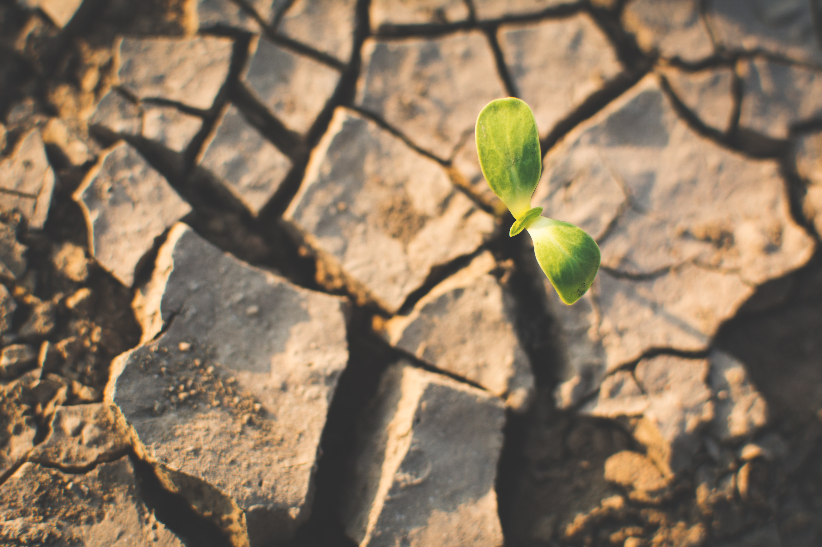
Threats to soil health
Erosion
Compaction
Organic matter loss
Loss of soil biodiversity
Nutrient imbalance
Waterlogging
Contamination
Soil sealing
Notes:
Erosion, compaction, loss of organic matter and increasing climate pressures.
Soil Erosion: Wind and water strip away the nutrient-rich topsoil, a risk affecting over 2 million hectares of soil in England and Wales.
Loss of Organic Carbon: Intensive farming causes soils to lose up to 60% of their organic carbon, destroying the structural stability and microbial activity needed to store carbon and nutrients.
Soil Compaction: Heavy machinery and trampling squeeze out pore space, restricting root growth and severely reducing water infiltration.
Nutrient Imbalance: Overuse of chemical fertilizers causes toxic runoff and eutrophication, while nutrient depletion degrades crop yields.
Loss of Soil Biodiversity: Agrochemicals, pesticides, and physical disturbance (like aggressive tilling) kill beneficial microorganisms and fungi essential for nutrient cycling.
Soil Contamination: Industrial spills, mining, and improper waste disposal introduce heavy metals and toxins, making land unfit for agriculture.
Soil Salinization and Acidification: The accumulation of excess salts and acidic compounds (often from acid rain or poor irrigation) damages plant health and inhibits soil microbe reproduction.
Soil Sealing: Urban expansion and concrete infrastructure cover land permanently, halting water absorption and ecological processes.
Waterlogging and Flooding: Poor drainage suffocates soil organisms and disrupts natural biological cycles.

Slide 8
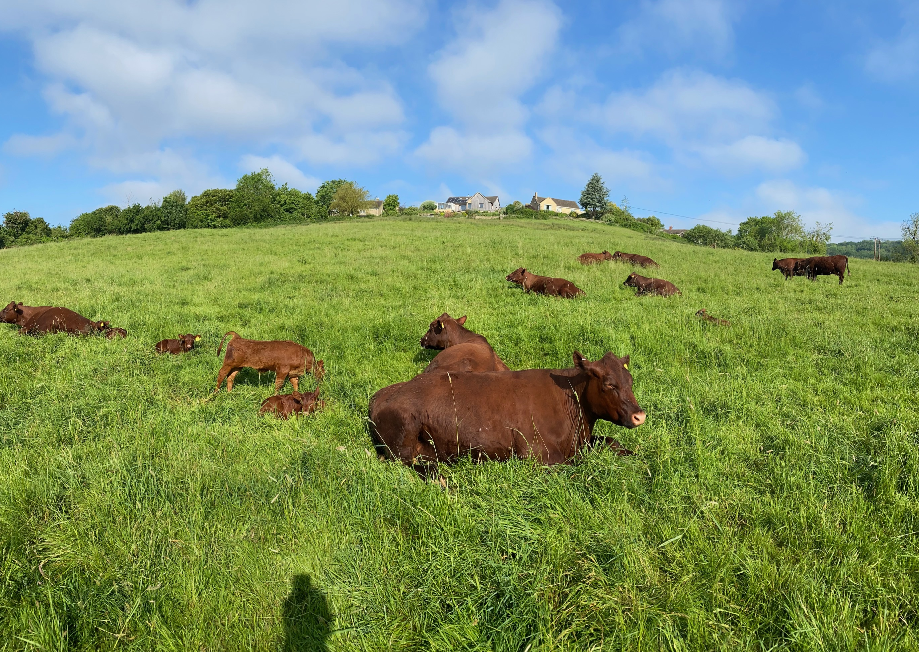
What should we do?
Protect
Improve
Restore
Enable
Engage
Notes:
Explain: Protect, Improve, Restore, Enable and Engage.
Protect – Protect soil health by preventing erosion, compaction, and the loss of organic matter.
Improve – Improve soil health through sustainable practices that enhance soil structure, fertility, and biodiversity.
Restore – Restore degraded soils by rebuilding organic carbon, improving biological activity, and increasing resilience.
Enable – Enable long-term productivity and environmental benefits by supporting healthy, functioning soils.
Engage – Engage farmers, land managers, and communities in adopting and promoting soil health practices.

Slide 9
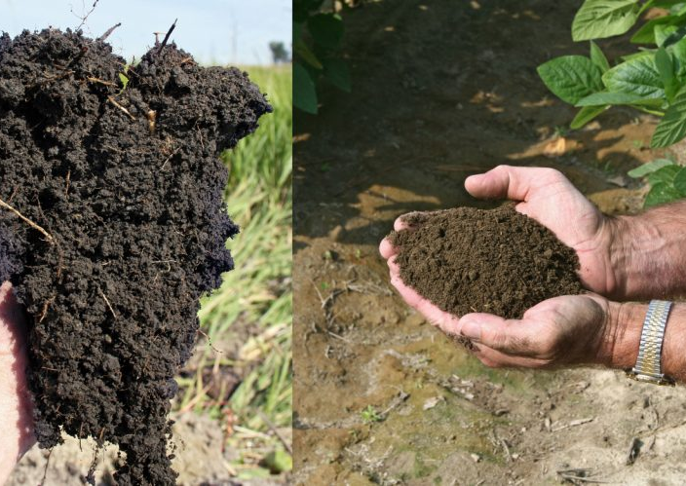
Recommended Local Actions
Who can make a difference?
  Councils
  Farmers
  Communities/individuals
Encourage household actions that protect and enhance soil health
  Don’t use herbicide
  Compost waste
  Practice “no dig” techniques in your garden
This Photo by Unknown Author is licensed under CC BY
Notes:
Aim to never have exposed soil – either to the sun nor to the rain
Plant cover crops,
Practice regenerative farming techniques – helping restore soil function
Plant trees and hedgerows,
Encourage agroforestry
Get community’s involved in understanding what is beneath their feet.

Slide 10
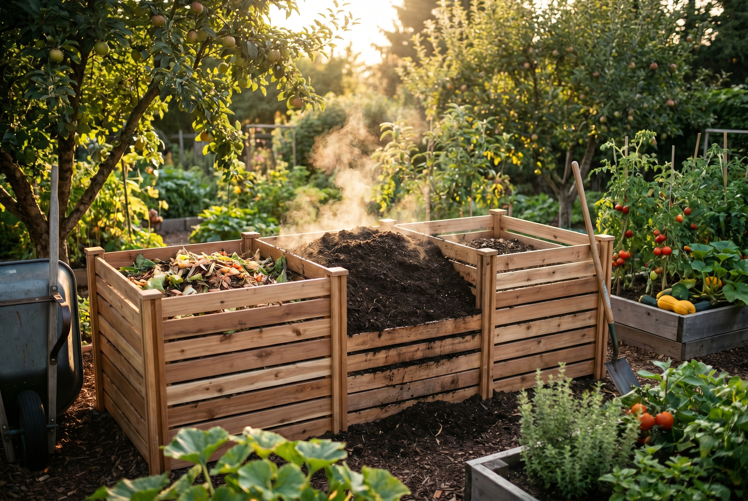
What can individuals do?
Compost garden and food waste where possible
Reduce soil sealing by minimising paving and using permeable surfaces
Plant trees, hedges and pollinator-friendly gardens
Buy food from local farmers using sustainable soil practices
Choose peat-free compost and don’t use roundup!
Support community growing projects and nature recovery initiatives
Notes:
Healthy soils are not only the responsibility of farmers and land managers. Residents can make an important contribution through gardening, purchasing choices and community action. Using peat-free compost protects valuable carbon-rich habitats. Increasing garden biodiversity, reducing hard surfacing and creating space for trees and pollinators all help support soil life. Supporting local producers who use regenerative farming practices can help drive wider landscape-scale improvements. Community orchards, allotments and volunteer conservation projects also provide opportunities for people to contribute directly to healthier soils and ecosystems.

Slide 11
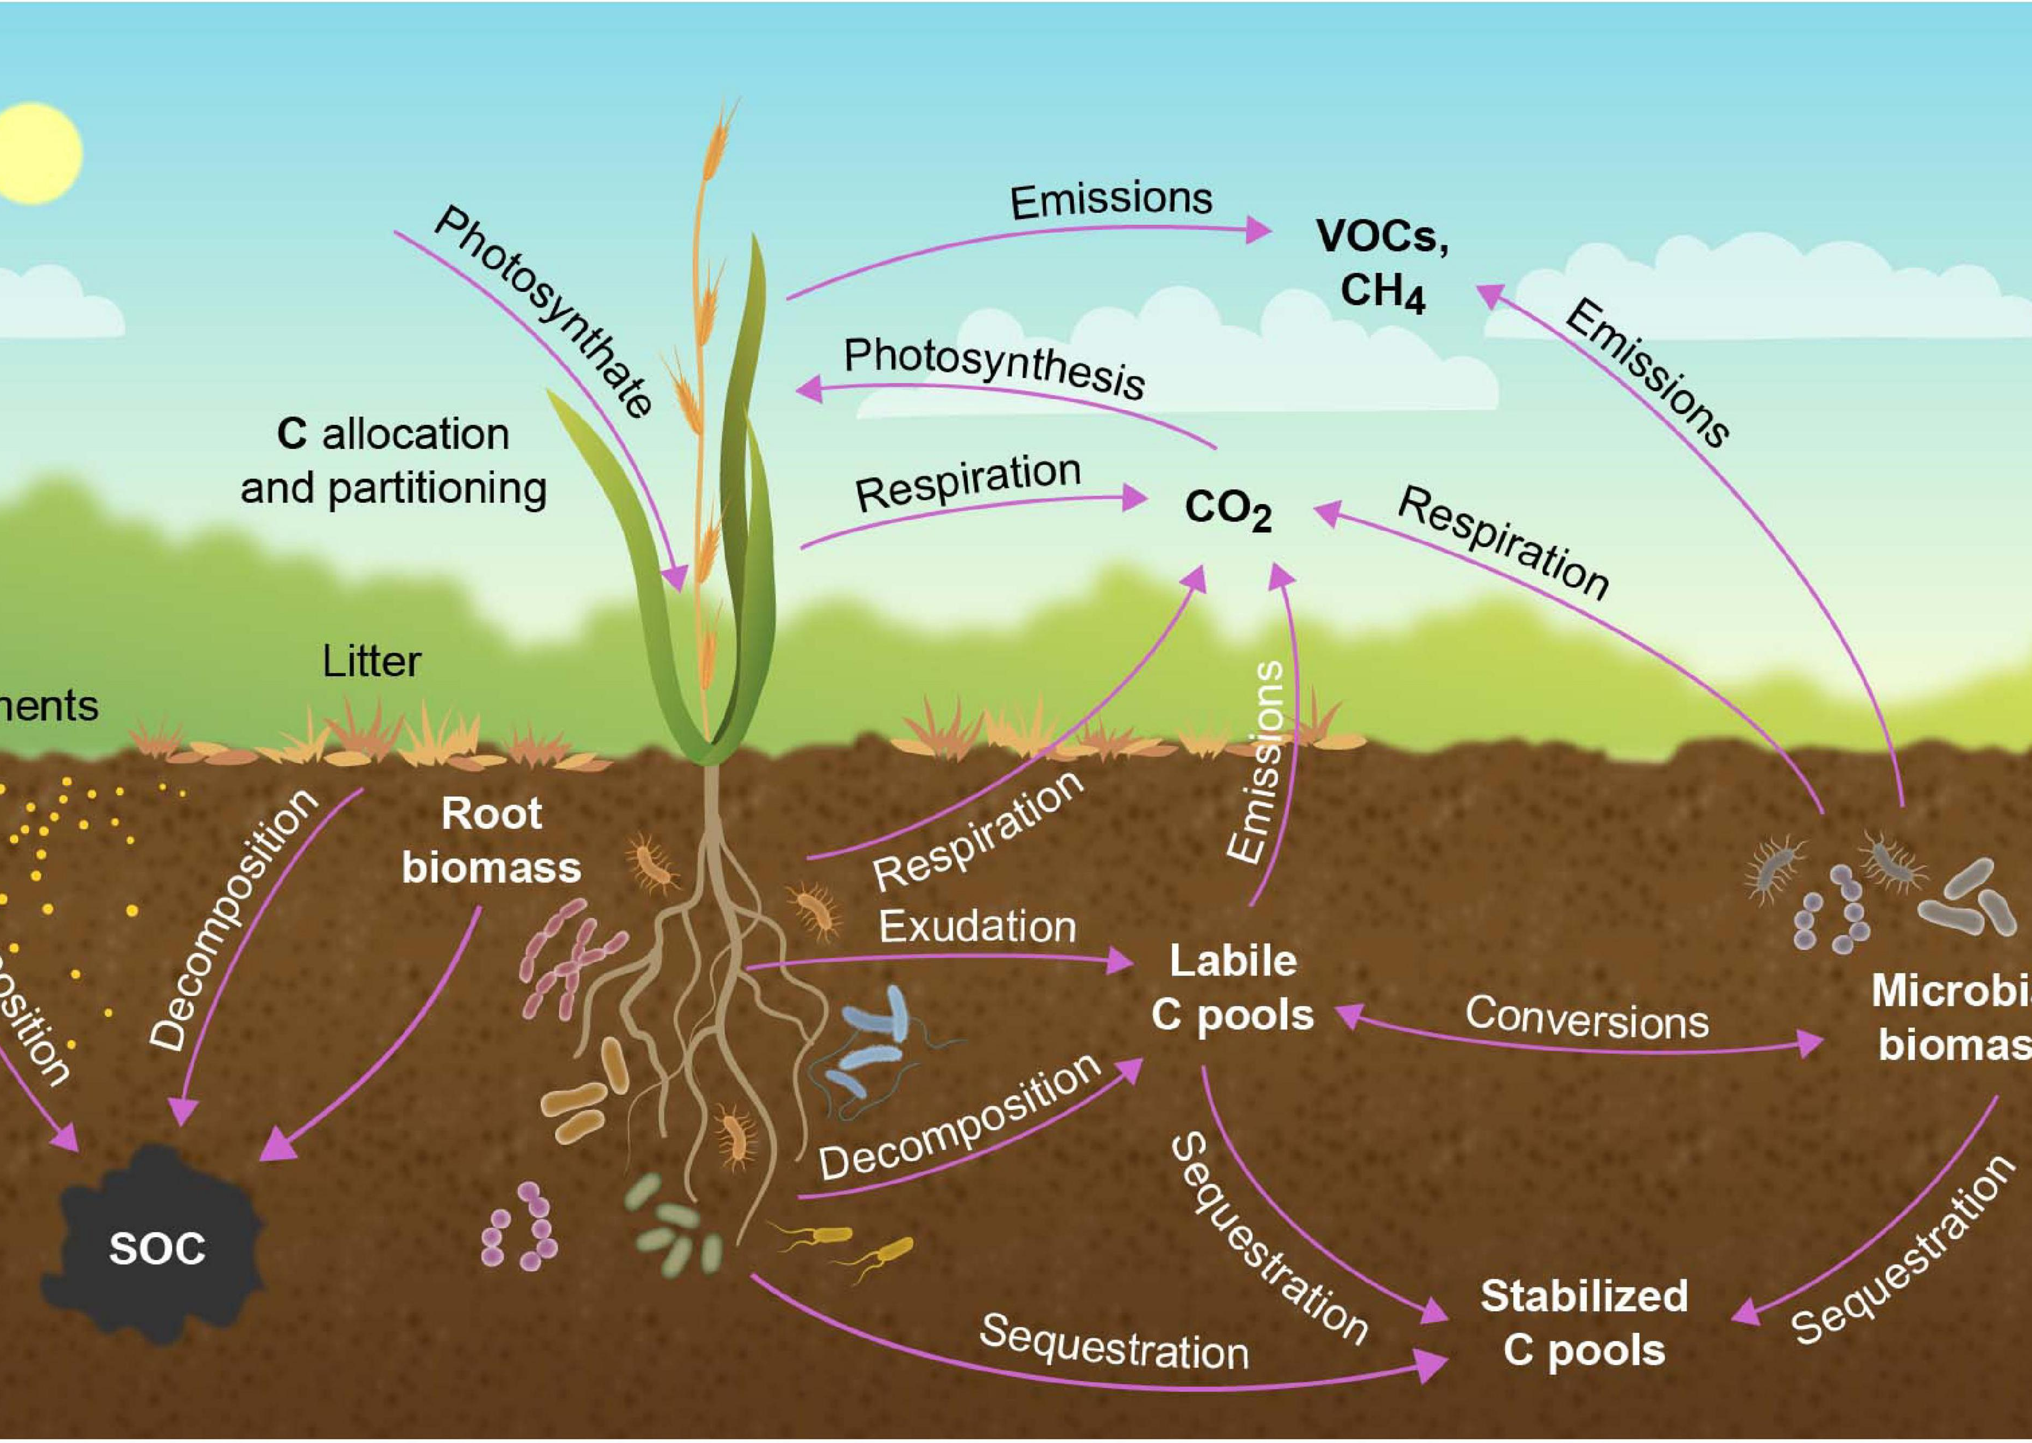
Call to Action
Healthy soil
Resilient future
This Photo by Unknown Author is licensed under CC BY
Notes:
Every resident, landowner, community group, farmer and public body has a role to play. Small actions taken across Gloucestershire can collectively improve soil health, increase biodiversity, strengthen climate resilience and support thriving local communities.
Investment in soil health delivers benefits for climate, nature, water, farming and communities.

Slide 12




Gloucestershire Master Composter project
Notes:
One of the easiest and simplest ways of improving your soil, encouraging and increasing the numbers of mico-organisms in it and making it more water retentive is to add compost. I work for Garden Organic and I have been invited here today to tell you about the Gloucestershire Master Composter project.
Making compost is something that is easy to learn to do, requires minimal equipment, recycles waste (garden and food)

Slide 13


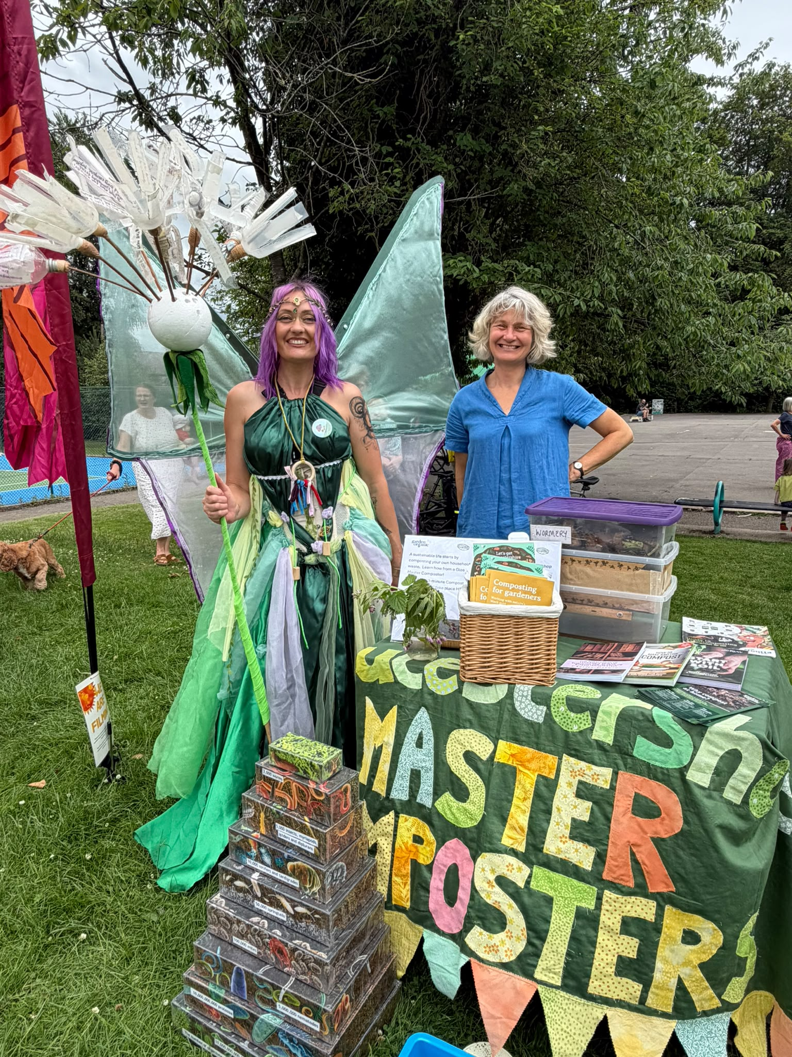
Contents
Garden Organic & the Master Composter ethos
Benefits of composting for people and councils owing
About the Master Composters
Compost demonstration sites
Composting in schools
Can we help your group or community to start composting?

Slide 14
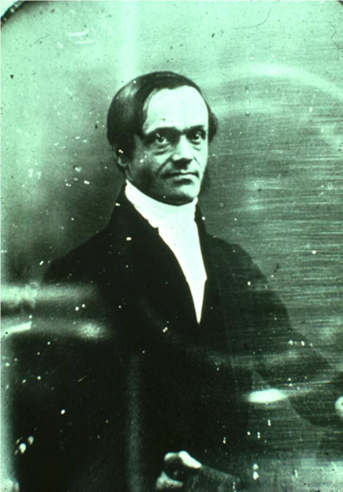
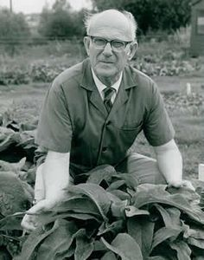
Garden Organic
Henry Doubleday: A 19th Century Quaker smallholder who brought the herb comfrey, a natural fertiliser, to Britain. He inspired our founder so much our charity was originally named the ‘Henry Doubleday Research Association’.
Our founder: Lawrence Hills.
Lawrence Hills, a freelance journalist and keen organic grower, founded our organisation in 1954. He was passionate about promoting the potential of the herb comfrey as a natural fertiliser and the benefits of organic growing as a whole.
Notes:
Garden Organic is a charity which since the 1950’s has been promoting organic growing and composting. Some of you may have known it as the Henry Doubleday Association and may have visited their beautiful gardens up in Ryton in Coventry which was a visitor attraction for many years and where the programme Muck and Magic was filmed in the 1980s. They also conduct conduct citizen science and research and through our Heritage Library they maintain a national collection of heritage vegetables and with the help of our members some of whom volunteer to grow the seeds for us in their gardens, the collection conserves vegetable varieties which might otherwise disappear.

Slide 15

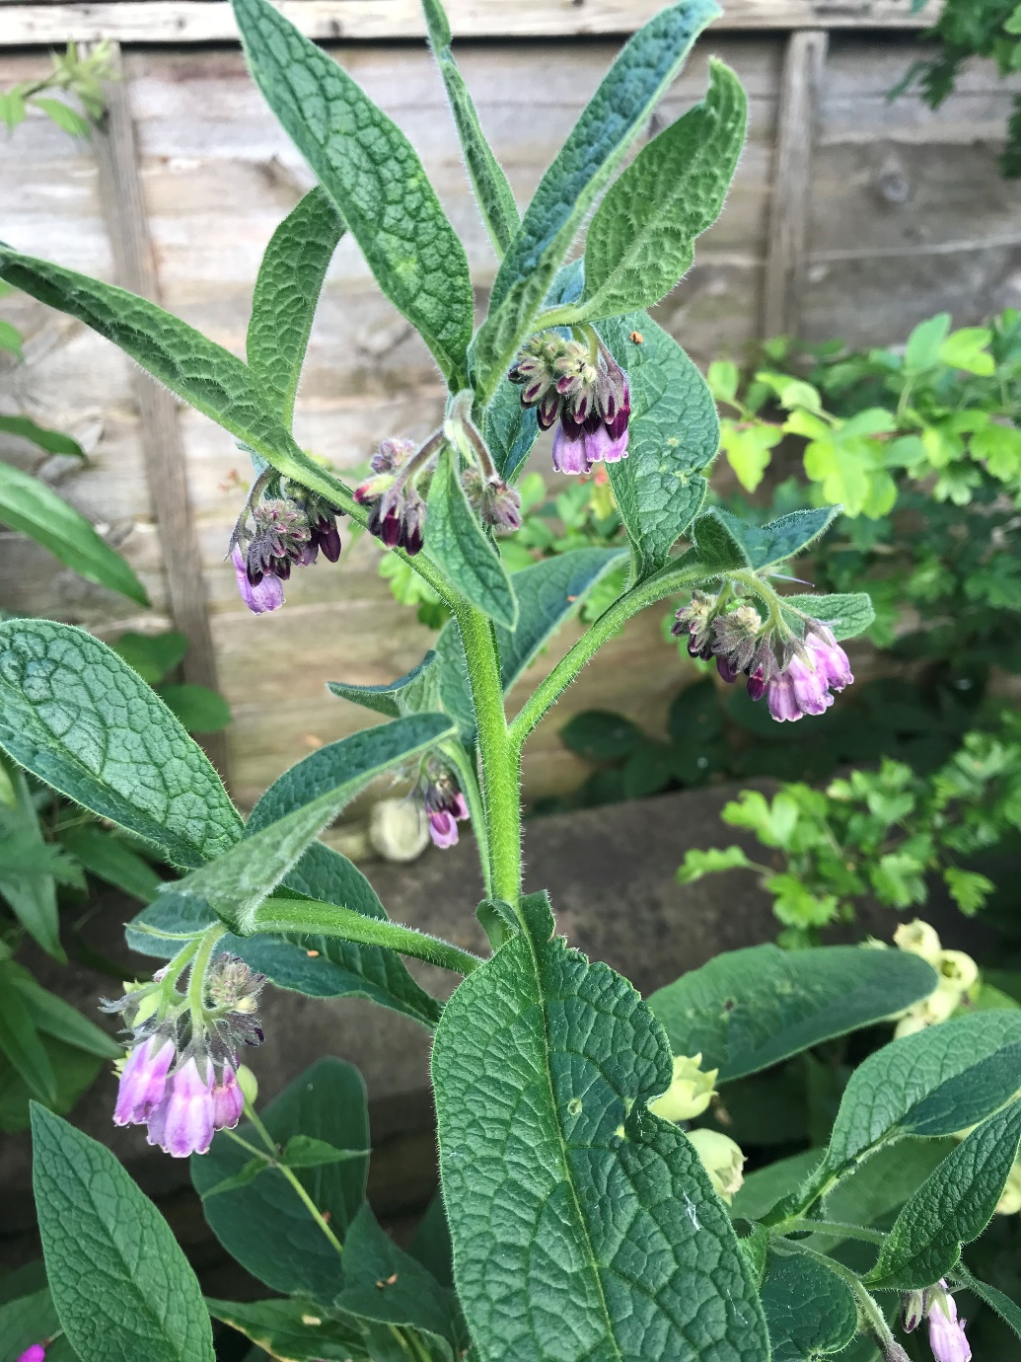

5 Principles of Organic Growing
Build and Maintain Soil Health
Encourage Biodiversity
Use Resources Responsibly
Avoid Using Harmful Chemicals
Maintain a Healthy Growing Area
Notes:
Here are the 5 principles of organic growing and you can see that soil health is the number one priority.

Slide 16
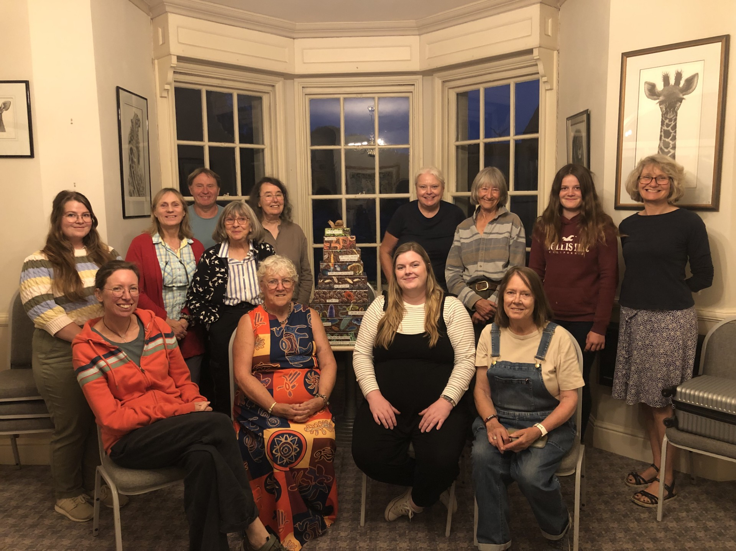
Gloucestershire Master Composters
Originally established in the USA and Canada
Garden Organic started first Master Composter programme in UK in 2001
Volunteers receive training and resources about home composting and free membership of Garden Organic see: https://www.gardenorganic.org.uk/
Volunteers commit time to composting education projects in the community
Notes:
The master composter concept is very simple – it involves training up people who are enthusiastic composters and equipping them to spread their skills and enthuse people in their communities to start making their own compost. The idea was first tried out in the USA and Canada but was then taken up by Garden Organic who’ve been promoting it in the UK since 2001 offering it as a service for local authorities who are keen to encourage residents to make compost at home.

Slide 17
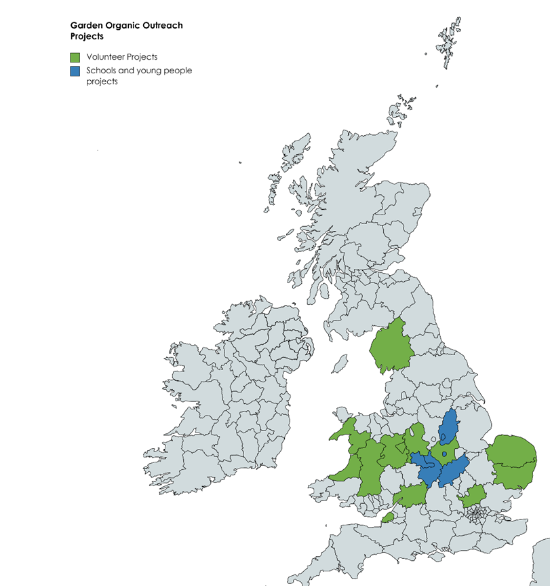



Our story
Schools projects:
West Midlands
Warwickshire
Northamptonshire
Leicester City
Nottinghamshire
Shropshire
Volunteer projects:
Buckinghamshire
Cumbria
Norfolk
Suffolk
Gloucestershire
North Somerset
Leicestershire
Shropshire
Ceredigion
Gwynedd
Powys
Worcestershire
Online training:
Falkirk
Essex
Dudley
East London
Notes:
This map shows where Garden Organic has run outreach reduction projects in the UK. Most of the projects are composting focused eg Norfolk has been going for 21 years. Some of them are more about recycling of waste and composting is therefore one element of that.

Slide 18
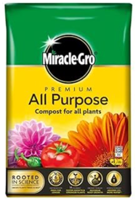
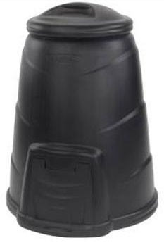

Why encourage residents to compost?
It’s good for people
Composting improves the soil and feeds plants in our gardens. It makes the soil more water retentive and helps it to lock in carbon
It can save people money - 1 x 330 litre compost bin = 8 bags x 40 litre soil improver @ £8 each = £64 pa
Reduced use of Council tips & collection services = less CO2 emissions and pollution
Physical activities in green spaces improve people’s health and wellbeing
It raises awareness of climate change issues and helps people feel they are doing something positive
Notes:
There are lots of reasons why we should all be composting:
It’s really good for our soil, which is good for the microorganisms and worms in it and which helps us grow plants and use the hosepipe less. Compost can hold twice its own weight in water and it improves the ability of soil to hold in carbon.
If you make your own compost you don’t need to go out and buy commercially produced soil improvers, all of which come in plastic bags.
It also reduces your need to take your waste to the tip or for the council to collect it which reduces fuel emissions and thus CO2 emissions.
Making compost is usually done in your garden and there is piles of evidence that proves that activities done in green spaces are great for our fitness and our mental wellbeing. I also think it empowers people making them feel they are doing something positive to address climate change and that they can make a difference.

Slide 19


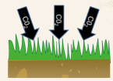

Why encourage residents to compost?
It’s good for councils
Encourages people to do their own recycling
Reduced pressure on Council services
Supports Councils’ commitments to Net Zero targets
Less pollution & happier & healthier people = less pressure on NHS
Notes:
From the Council perspective, there has long been a push to reduce pressure on our services and to encourage people to take responsibility for recycling their own waste. Most councils have pledged to work towards Net Zero which is very hard and any contribution is helpful. And we all want to live in an environment which has as little pollution as possible

Slide 20
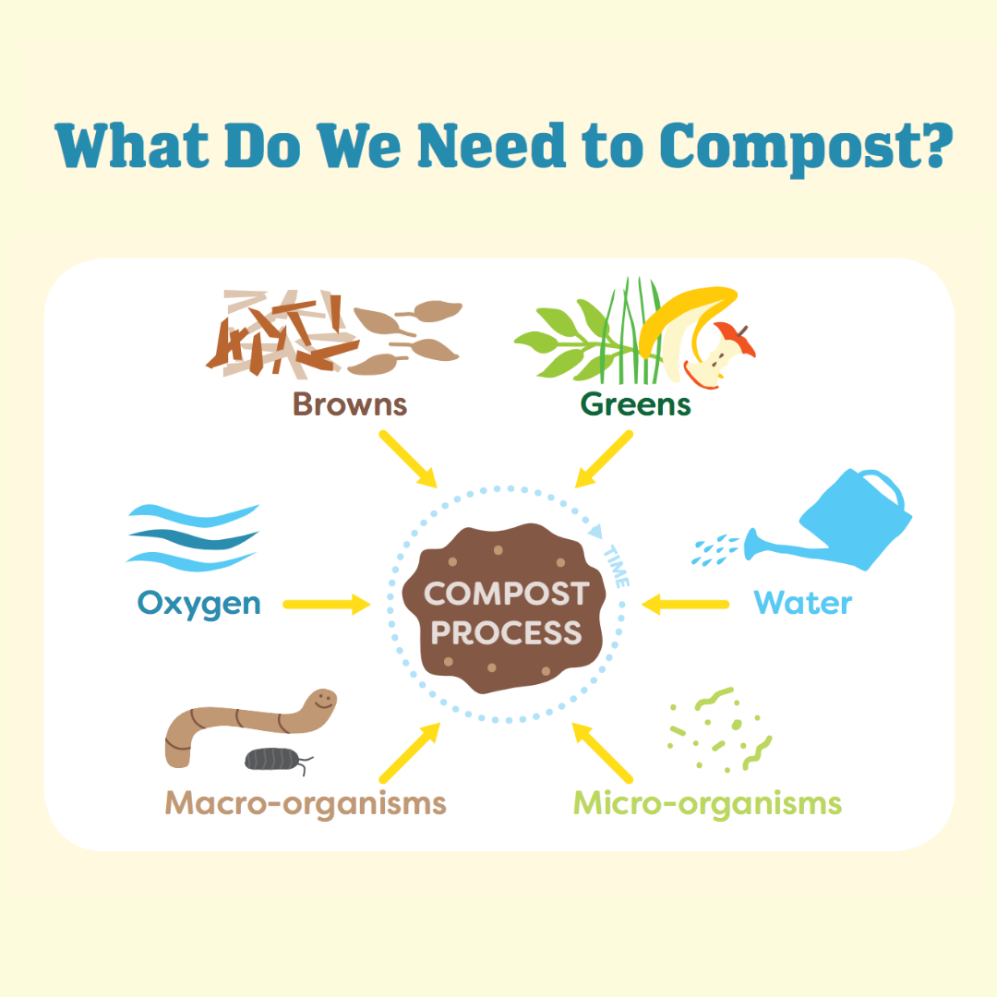
What is composting?
Composting is the process of producing compost through aerobic decomposition of biodegradable organic matter.
Key ingredients are:
Green organic matter rich in nitrogen to provide moisture & speed up decompostition
+
Brown organic matter, rich in carbon to provide structure & airflow
The decomposition is performed primarily by microscopic organisms, although larger creatures such as ants and worms also contribute.
Notes:
I’m not going to dwell long on the composting process itself today as that is a subject of another workshop BUT in summary to make good compost you need a mixture of greens which would be your garden waste, your grass and clippings, your spent flowers and vegetables plus also some of your kitchen waste (veg and fruit peelings, coffee grounds, tealeaves, eggshells etc. Composting is about aerobic decomposition so to stop all that nitrogen rich material just rotting into a slimy mess you must mix in browns in the form of woody garden prunings, wood chip, brown corrugated cardboard, shredded paper, toilet roll inners, egg boxes, scrunched up newspaper etc etc. You will need to check your ingredients are damp enough and have enough air flow and then all you need to do is let the bateria and microorganisms do their work and break it all down over several months. In short you are trying to replicate and speed up what happens naturally in a wood.

Slide 21
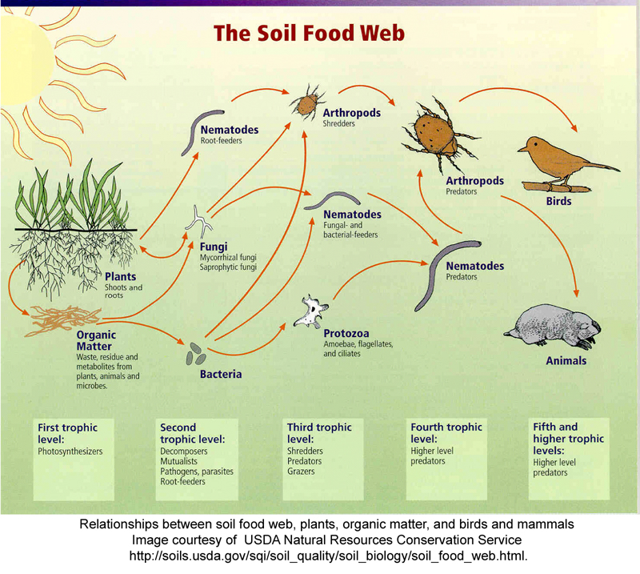
Compost creatures…
Notes:
Here are a couple of graphics of the creatures that are integral to the Soil Food Web that do the composting work for us. Most of them are invisible to us without a microscope

Slide 22
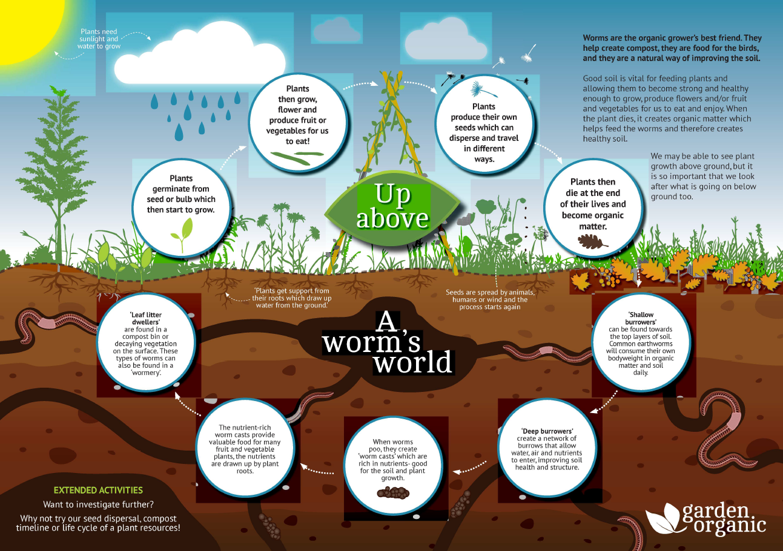
Compost creatures…
Notes:
Although not the worms which really do the heavy lifting

Slide 23
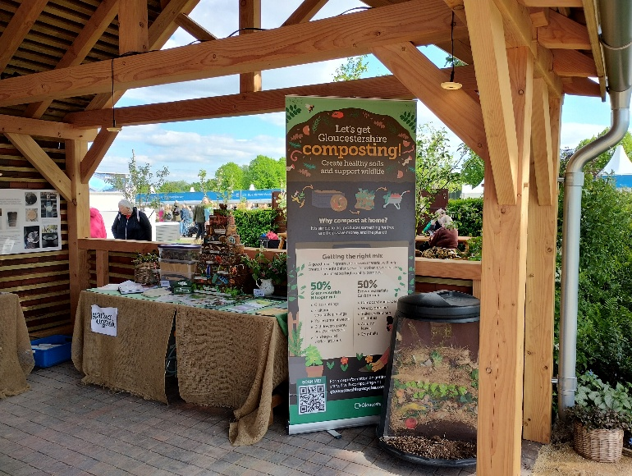
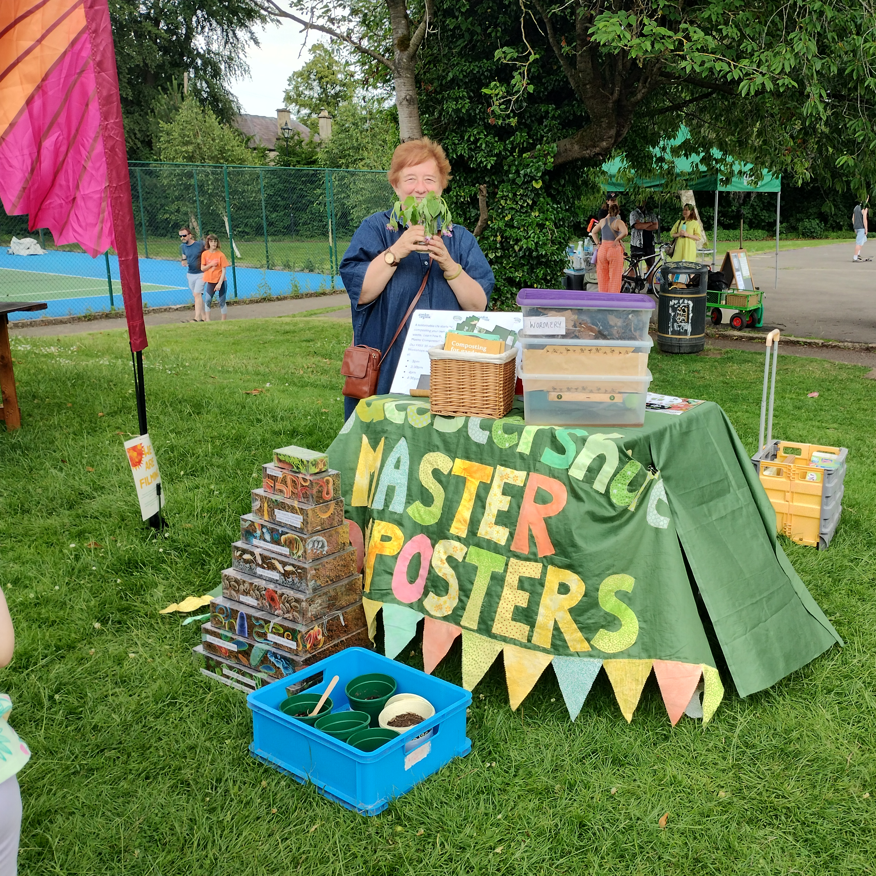
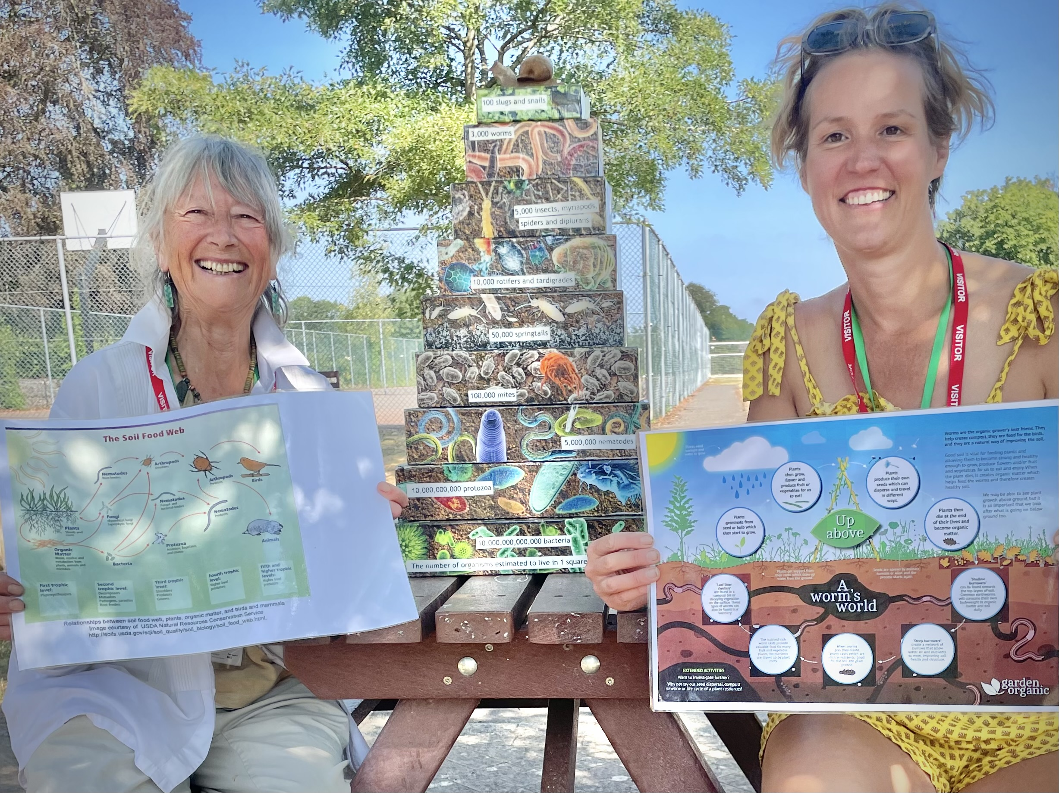
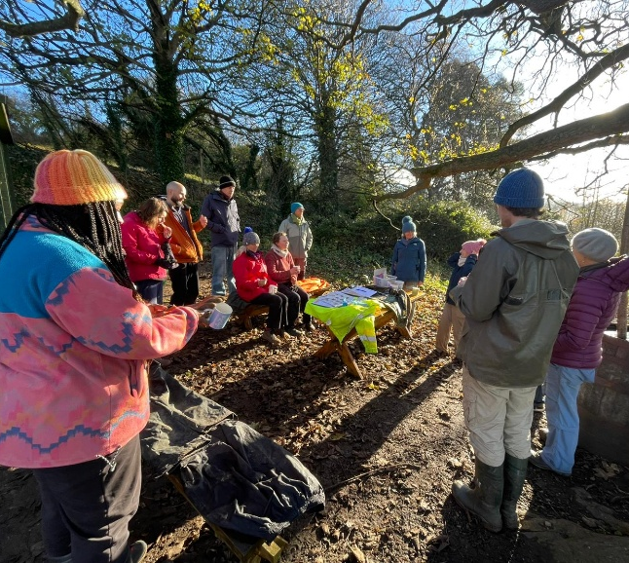
The Master Composter project
A two year project comprising:
Garden Organic training, resources & research eg an online composting basics course available to all Glos residents
+
One p/t co-ordinator (2.5 days/week) to support 25 Master Composters – experienced and enthusiastic volunteers who:
Man information stands at events eg village shows, Cirencester Big Lunch, the Great Big Climate Circus, Hawkwood College Open Day, Speech House Food Festival & RHS Malvern
Give composting workshops & presentations to community groups eg allotments, gardening clubs, dementia clubs and at libraries and parish council meetings
Give one-to-one advice to local people in their communities and gardens
Notes:
Gloucestershire County Council Waste team have recruited and supported a team of master composters for some years now but in 2025 the Gren Party allocated additional funding in order to commission Garden Organic to expand the delivery for a 2 year period. I now co-ordinate the project, working 2 ½ days per week. We have doubled the number of master composters to 25 now and we are working hard to educate local residents to start composting. The Master Composters do this by manning stalls at all sorts of different events eg Hawkwood Open Day, Cirencester Big Lunch and this year we were invited to have a stand at the main feature garden at RHS Malvern.
We give practical workshops for community groups and allotments and libraries and parish council meetings
Local people and community groups can also get one to one composting advice from a Master Composter who will visit a private or community garden to help set up or improve composting.

Slide 24
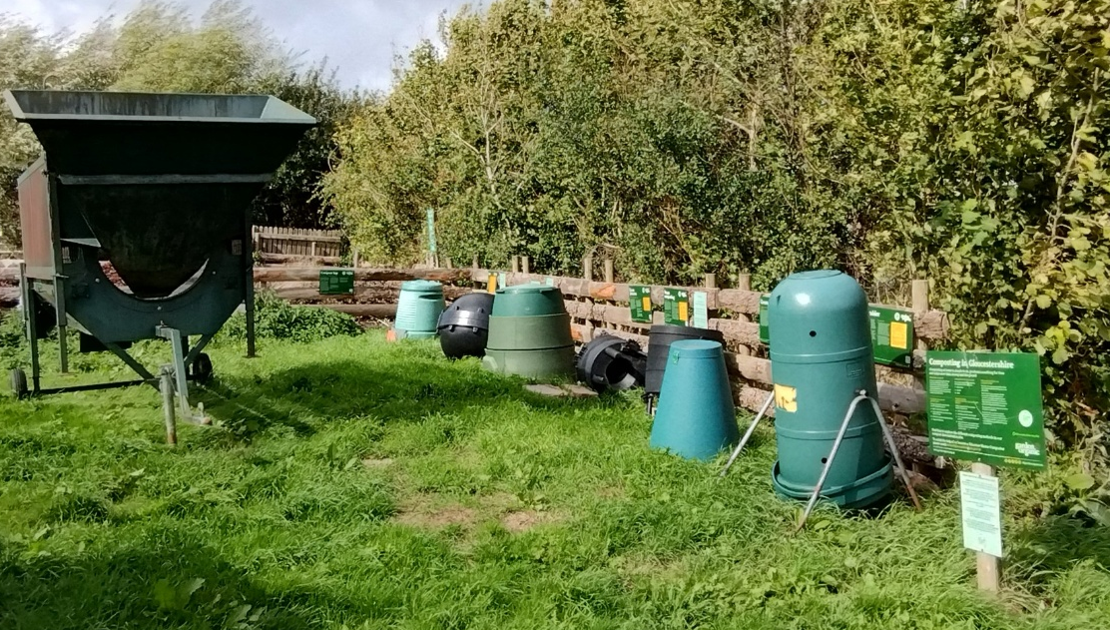
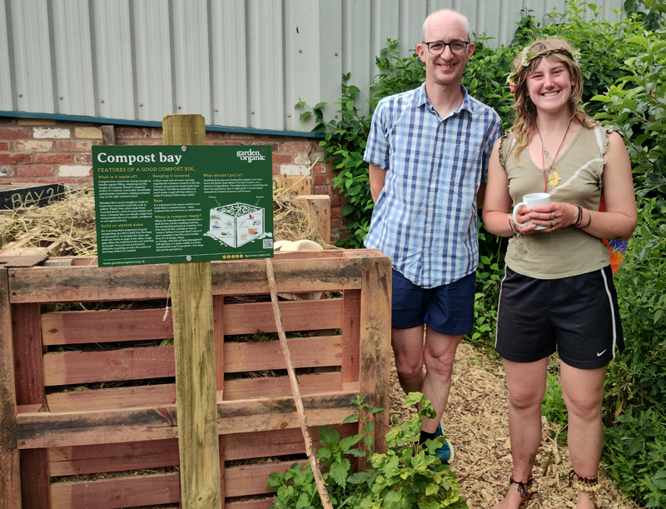
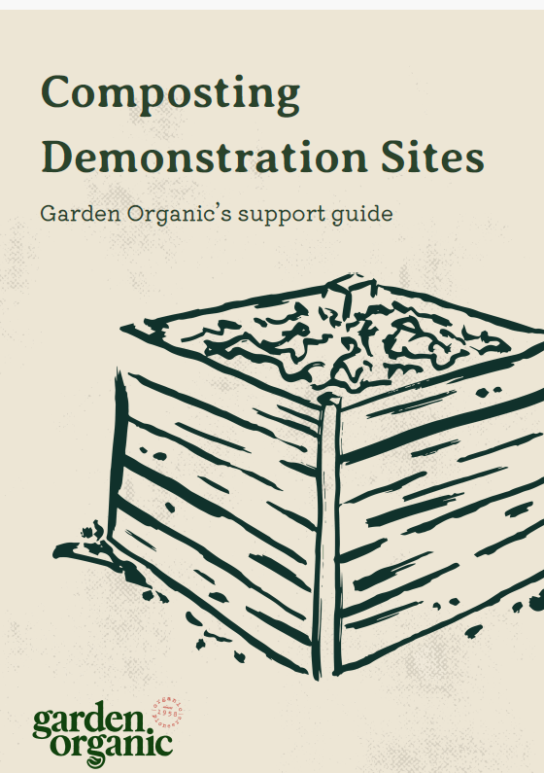
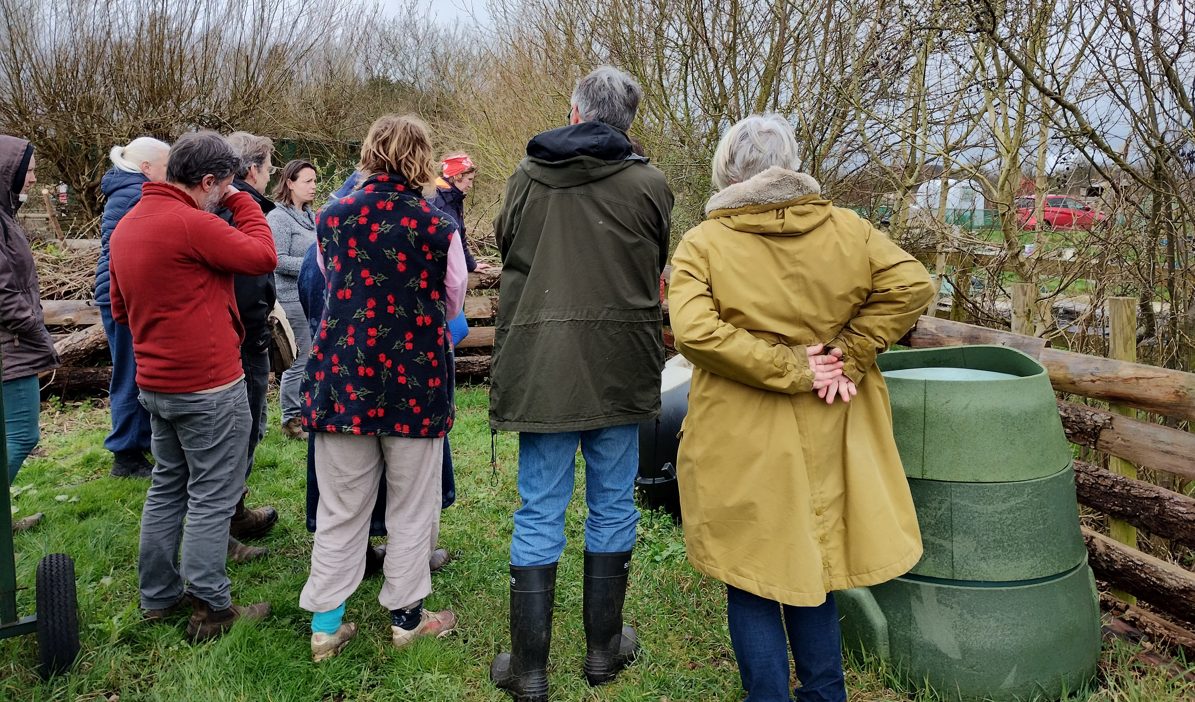
Compost demonstration sites
Public spaces where people can see different composting techniques in action.
Appealing Garden Organic branded signs explain the pros and cons of each method on display
Notes:
One element of Garden Organic’s compost offer is the establishment of composting demonstration sites where members of the public can go and see how to do different methods of composting and work out what would work for them and what equipment they would need. They need to have a range of options on show and we provide the signage that explains how they work and the pros and cons. In Gloucestershire for many years our only demo site has been at Bisley Community Composting Site. This year Project Grow based at the Heritage Hub in Gloucester has recently become one and there are two new ones being set up in the Forest of Dean. Next year I am keen to identify sites in Cheltenham Tewkesbury and Cotswold district.

Slide 25


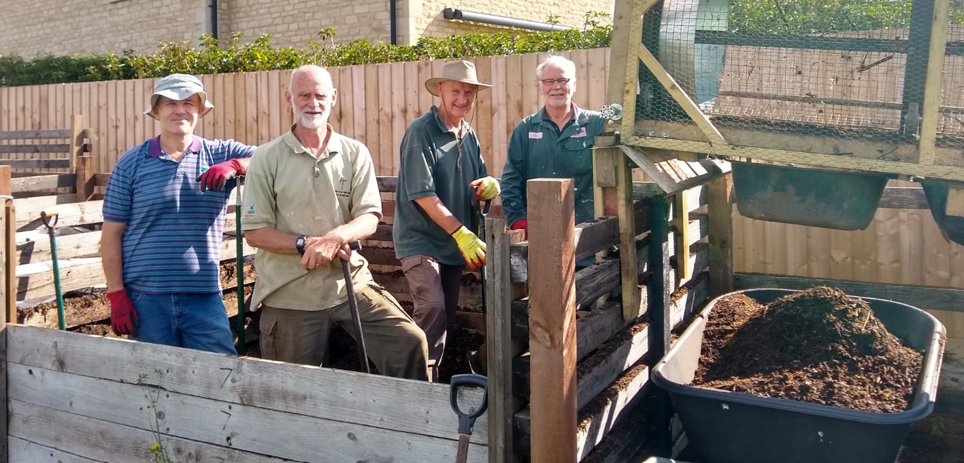


Community Composting Sites
Bisley Community Compost Scheme
A Compost Demonstration Site open every Saturday morning. See:https://bisleycommunitycompostscheme.org.uk/
21st Anniversary Celebration on 15th August – everyone welcme!https://bisleycommunitycompostscheme.org.uk/
South Cerney parish compost site
Established 17 years ago. Open on Wednesdays, contact through Facebook m%20composting%20
Brimscombe & Thrupp Community Composters (BATCOM)
Newly established in 2025. Open Saturday mornings. See: https://www.batcom.org.uk/
Notes:
In Gloucestershire we are fortunate to have 3 community composting sites and we would like to encourage more. So one of the remits of this role was to set up a network through which groups could network and share information and support any groups trying to get a new site off the ground. We had an initial meeting in January followed by a site visit to South Cerney in April. We have also recently produced a guide to setting up a community composting site foicussing on BATCOM’s recent experience and I am organizing a third meeting for September.

Slide 26
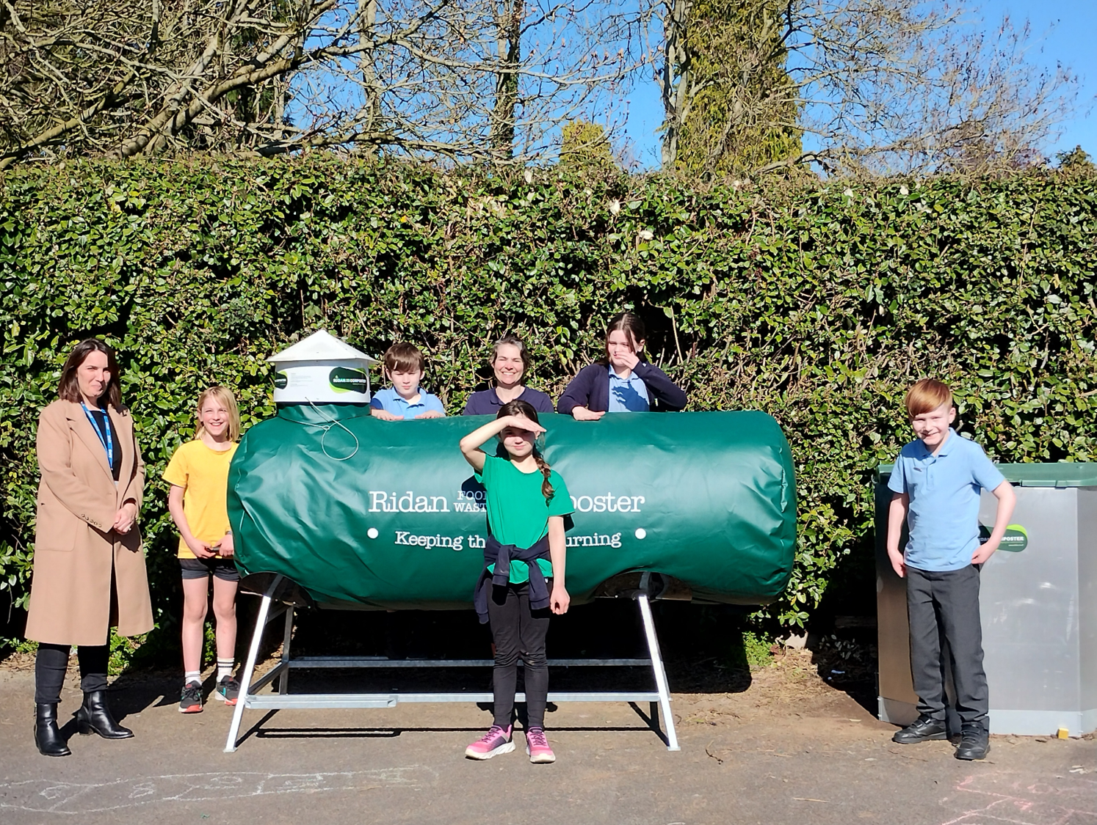
Composting in schools
Empowering and inspiring the next generation!
Helping schools to recycle their waste saves £££
March 2025 New regulations require schools to separate food waste
Dec 2025 – 40 responses to compost survey sent to all schools by GCC Waste Team
Master Composters followed up & have supported:
6 primary schools +
3 secondary schools to start using dalek bins to compost garden waste
6 schools to start composting food waste (2 Ridan tumblers, 4 hotbins) PILOT PROJECT for Glos
The British School at Wotton-U-Edge, April 2026
Eco Council welcomes new Ridan composter
Notes:
Working with schools is a really positive experience for us Master Composters. On a practical level composting supports the school curriculum – science, maths, food & nutrition & art and activities eg forest schools, gardening clubs & Eco Councils
Teaching them to make compost helps them to recycle their waste and this saves them money. For example they currently pay to have cardboard and paper waste removed and since March 2025 they have been required by central government to separate out their food waste from general waste and they now have to pay for it to be removed off site.
But this is also about inspiring the next generation to think about climate change and the impact of human consumption and costs of disposal and hopefully some of them will have formed a new habit to take into adulthood as they become householders themselves. We worked closely with the GCC Waste Team on this project who sent out a compost survey to all schools at the end of last year. The Glos Master Composters followed up on schools which received new compost bins and some
GCC

Slide 27
How to start composting today
Take Garden Organic’s FREE online composting course (45 minutes) at: https://gardenorganic.mylearningapp.com/course/view.php?id=44
Guest Passcode: GloucesterCompost
AND ORDER YOUR COMPOST BINS
Gloucestershire residents can claim £15 off any compost bin! Go to:
www.getcomposting.com
www.greatgreensystems.com
Notes:
I;m going to finish with some messages for you firstly as Gloucestershire residents you are all entitled to take the Garden Organic Composting basics online course. This will help you to decide what system would suit you and then you can receive a £15 discount from any composting equipment purchased through the County Council’s website.

Slide 28
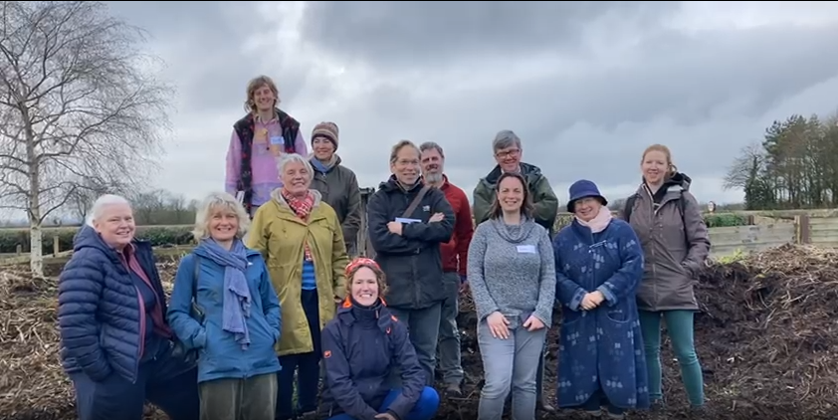
Could you be a Master Composter?
If you are a compost enthusiast and want to help other people to start composting then join the Glos Master Composters.
Training, resources and support provided PLUS free membership of Garden Organic. Email kphimister@gardenorganic.org.uknscT PROJECT for Glositompostscheme.org.uk/
Notes:
Perhaps you are already making your own compost and like meeting new people and sharing your skills and enthusiasm? If so, please join our team. We are really friendly and like working together and have regular socials

Slide 29
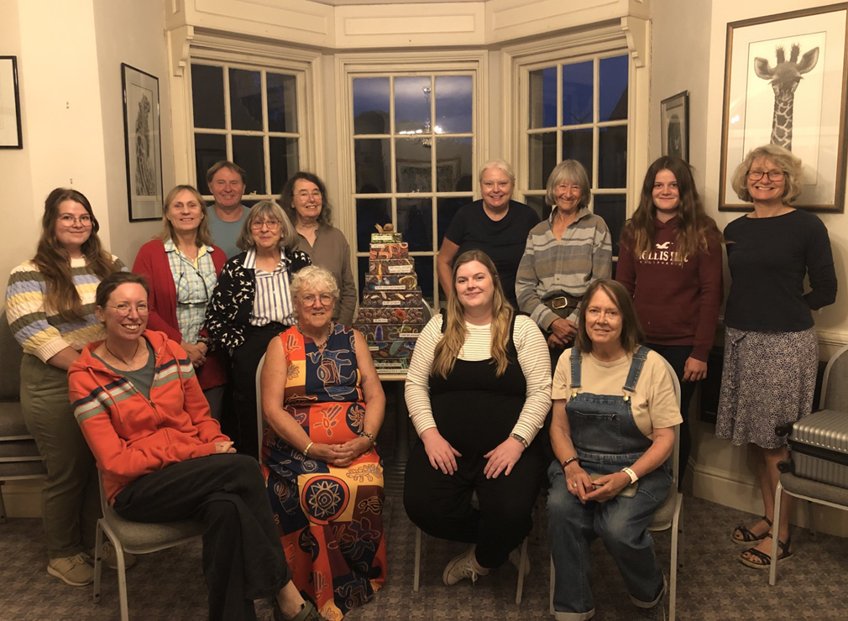
Help spread the message…
Which groups are you working with that could benefit from making their own compost?
Could you invite us to meet your group or community?
Get in touch by emailing kphimister@gardenorganic.org.uk
Notes:
And finally, I’m hoping that in the room today there are some new partners who think we could support the groups or organisations they are working with and will get in touch with me and invite us to meet them. If so, please get in touch

Slide 30
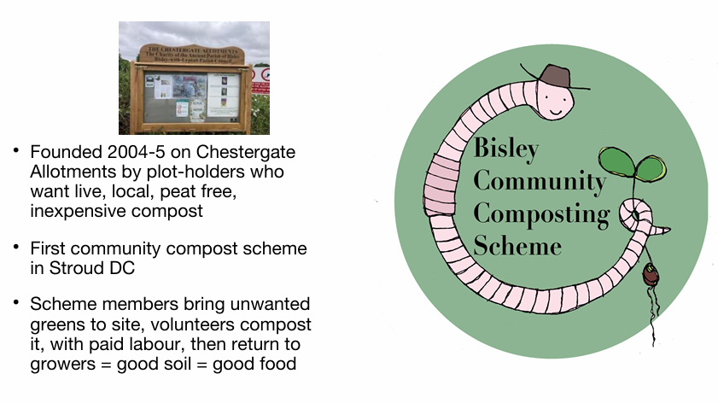

Slide 31
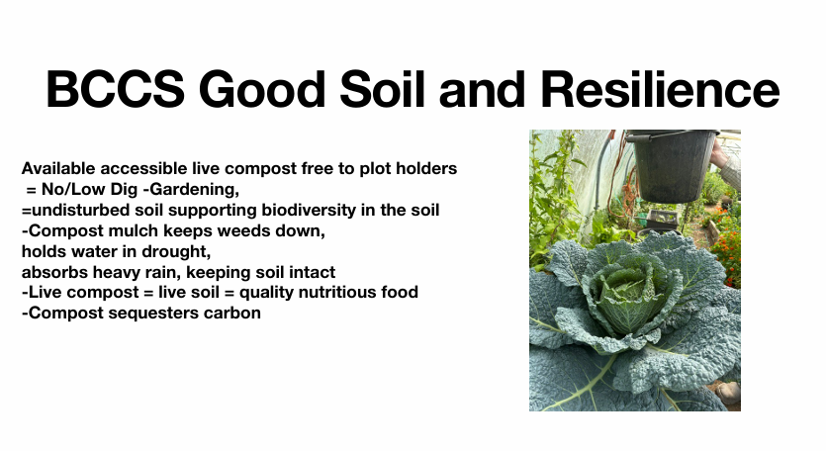

Slide 32
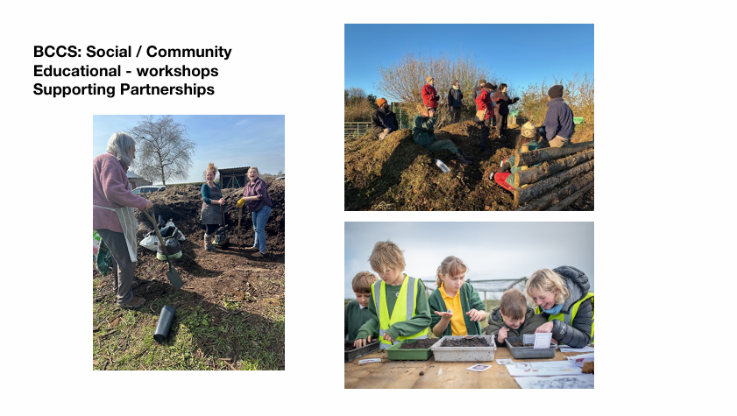

Slide 33
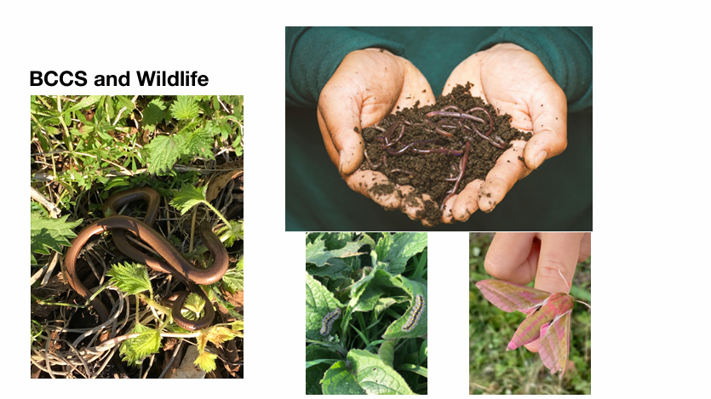

Slide 34
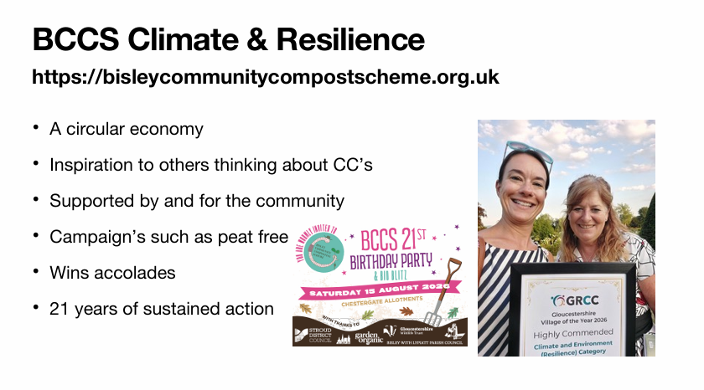

Slide 35
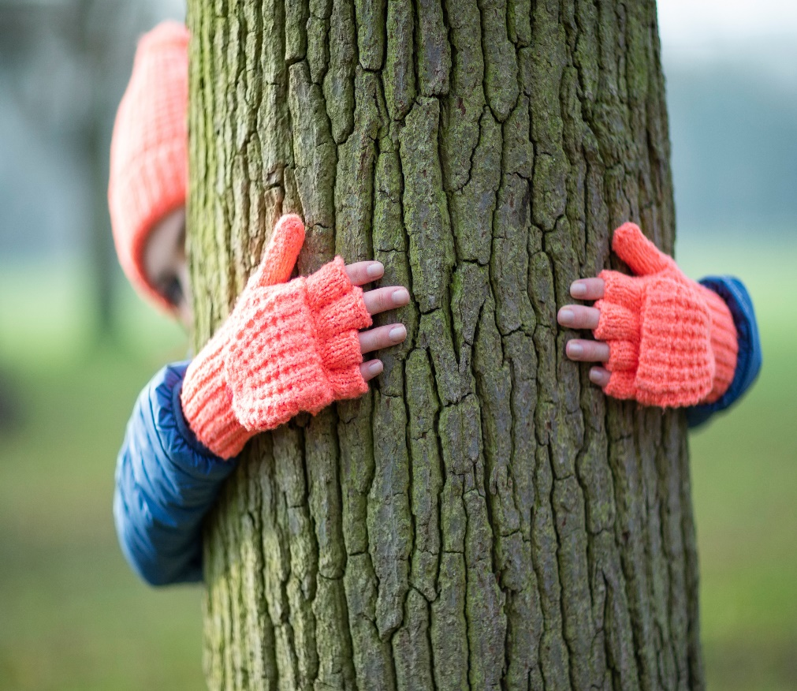
partnership opportunities
  (there will be time for a break after this!)
    How can partners enable private and community composting schemes?
  Georgia, Chris, and Rebecca will then feedback to the wider group

Slide 36

Short break

Slide 37
Reducing waste
Kelly Osborne – Sustainability and Engagement Officer

Slide 38

Notes:
The waste partnership has a comms and engagement group made up of the seven councils, it is attended by waste officers and comms officers to plan engagement activity over the year. We have a combined (very small) budget to support waste min work and a terms of reference that outlines how we work together to communicate about waste min and recycling.
We work under the banner of Gloucestershire Recycles, this is a Recycle Now brand and aligns with national branding on recycling and waste min messaging.
Reducing waste rather than recycling is essential to carbon emissions reduction. Focussing on emissions reduction by waste reduction is around six times more effective at reducing carbon emissions that encouraging recycling.
Emissions from the treatment of waste contribute to approximately 5% of total UK greenhouse gas emissions. Six times more local emissions come from the purchase of new goods and services - 31% of resident emissions (Gloucestershire ‘pathways to net zero’ report, 2025).
https://assets.publishing.service.gov.uk/media/67e3e0f79137aeade25de022/2024-provisional-greenhouse-gas-emissions-statistics-statistical-summary.pdf

Slide 39
🍌Food waste reduction
🥻Clothes swap kit
♻️New waste hierarchy
🔧Repair café network
🧙Waste Wizard
🪴Composting
👶Reusable nappies
What are we up to?

Slide 40
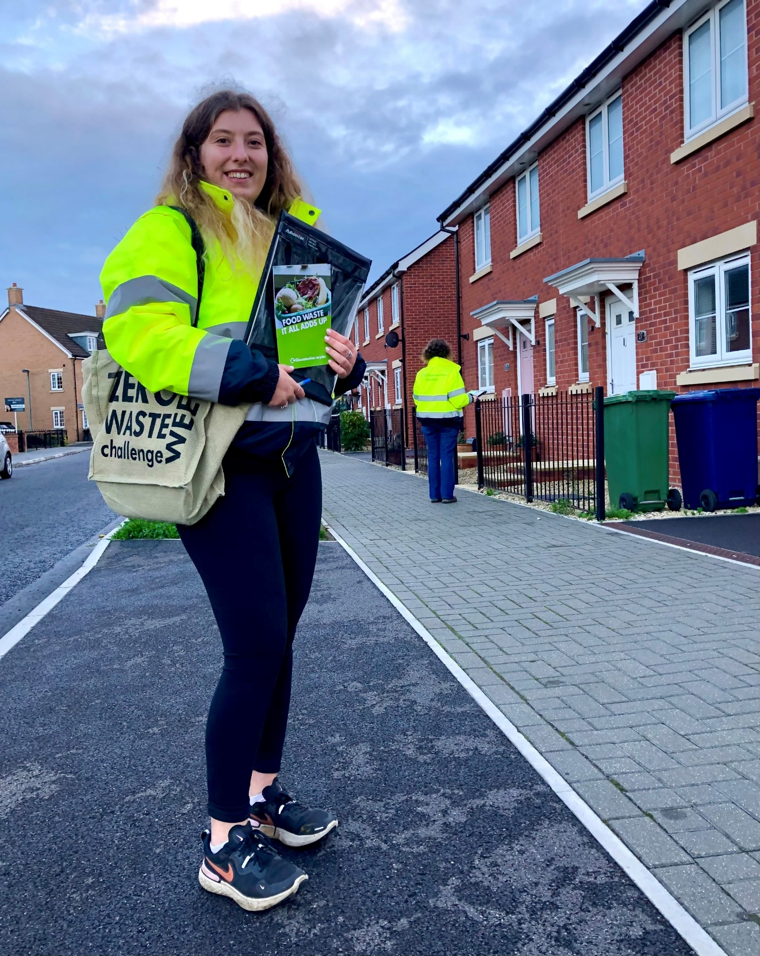
What are we up to?
Notes:
Food waste door knocking has happened in 2022, 2024 and this year, it helps us understand what the barriers are to residents participating and increase rates
We are also hoping to do wider work on exploring barriers to stopping food waste with small groups of residents through an external engagement organisation – pending advertisement on our procurement system

Slide 41
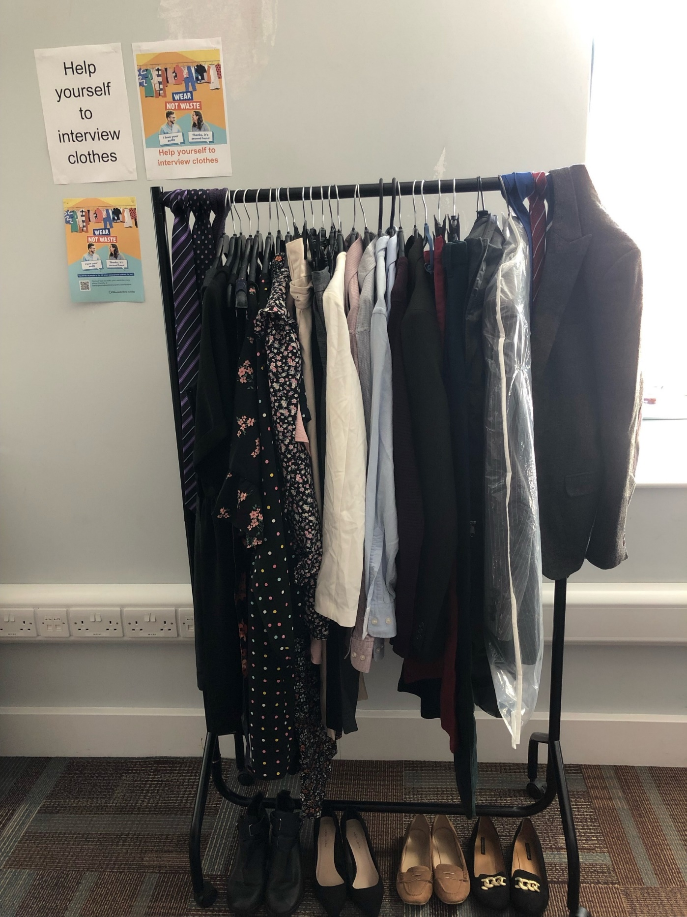
What are we up to?
Notes:
Clothes swap kit has been available since second hand September 2024? Or 23? And is borrowed by schools and community groups. We estimate that it has saved around xxx tonnes of carbon per year compared to if people bought new items.

Slide 42

What are we up to?
Notes:
Clothes swap kit has been available since second hand September 2024? Or 23? And is borrowed by schools and community groups. We estimate that it has saved around xxx tonnes of carbon per year compared to if people bought new items.

Slide 43
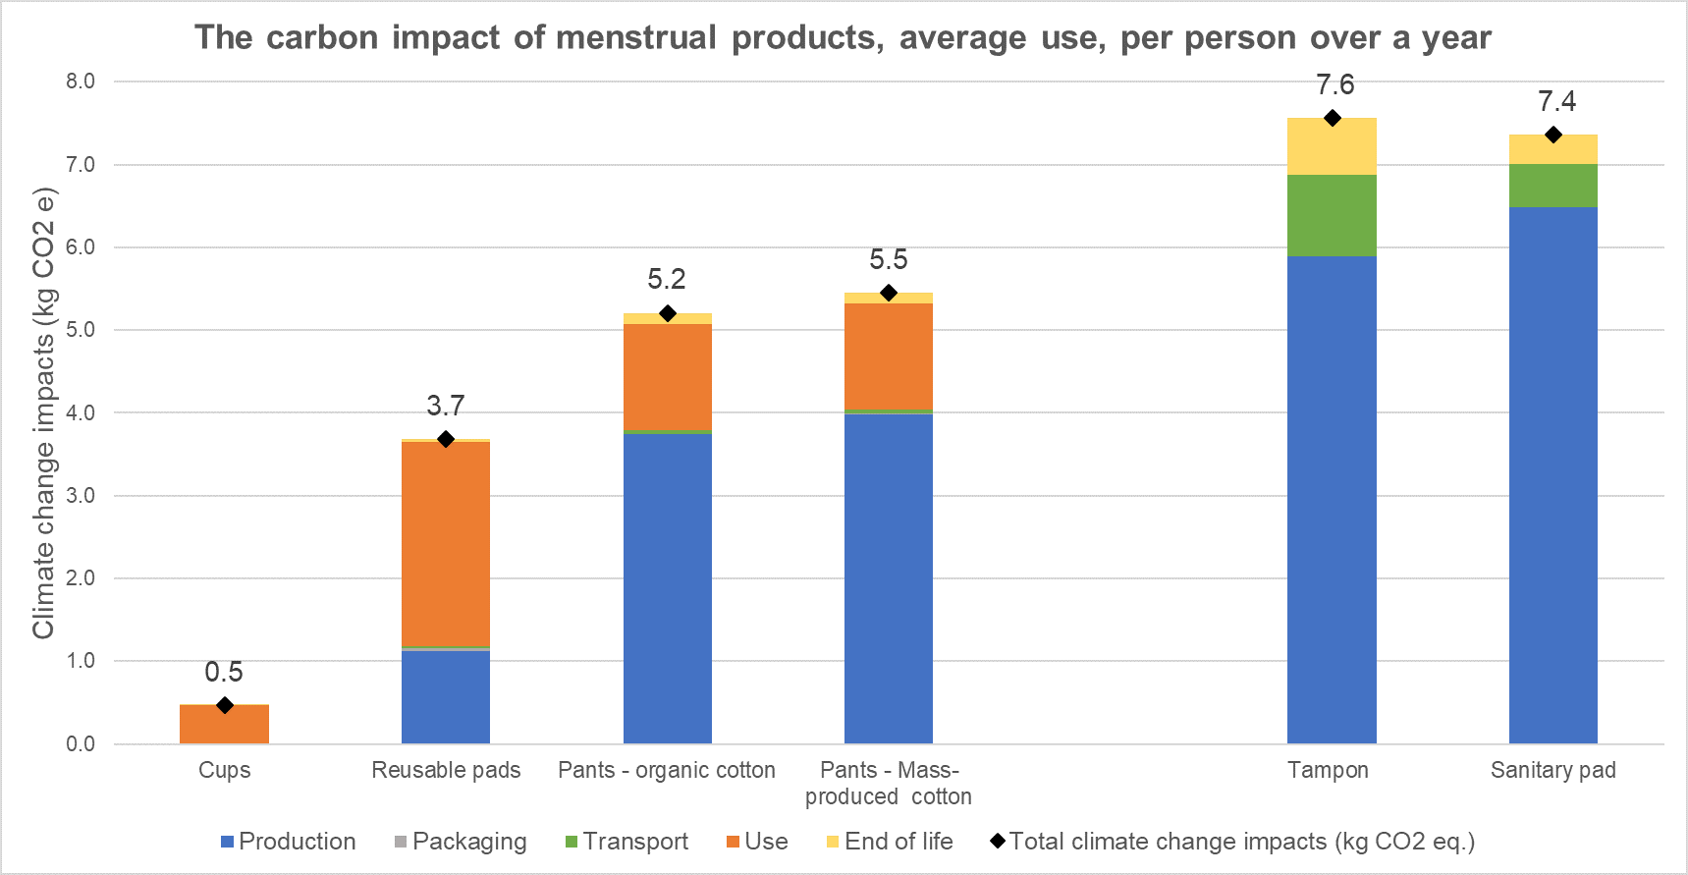
💷 Saves Money - £50 a year
🛠️ Reduces waste – 11,000 plastic items over a lifetime
🌳 Reduces carbon emissions -
🧘 Health benefits
Why go reusable?
Notes:
7kg of co2e is around 50km travel on a plane

Slide 44
Contact me for more information kelly.osborne@gloucestershire.gov.uk
Food waste door knocking
Flexible plastics recycling
What are the next steps?

Slide 45
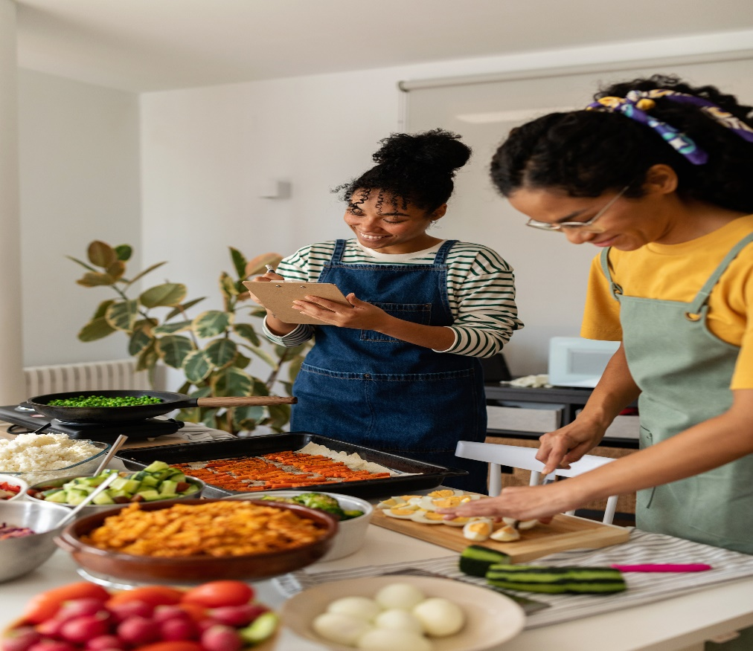
Cllr Tricia Watson
  Gloucestershire Waste and Recycling Partnership

Slide 46
Shalize Nicholas
  Local Repair Initiatives

Slide 47
partnership opportunities
  3 breakout groups for discussion on:
    How can partners Promote and encourage reuse, refill and repair across the district?
  Georgia, Chris, and Rebecca will then feedback to the wider group

Slide 48

Partner updates
  Any urgent updates
    (non-urgent can be emailed for circulation to climate@stroud.gov.uk)

Slide 49
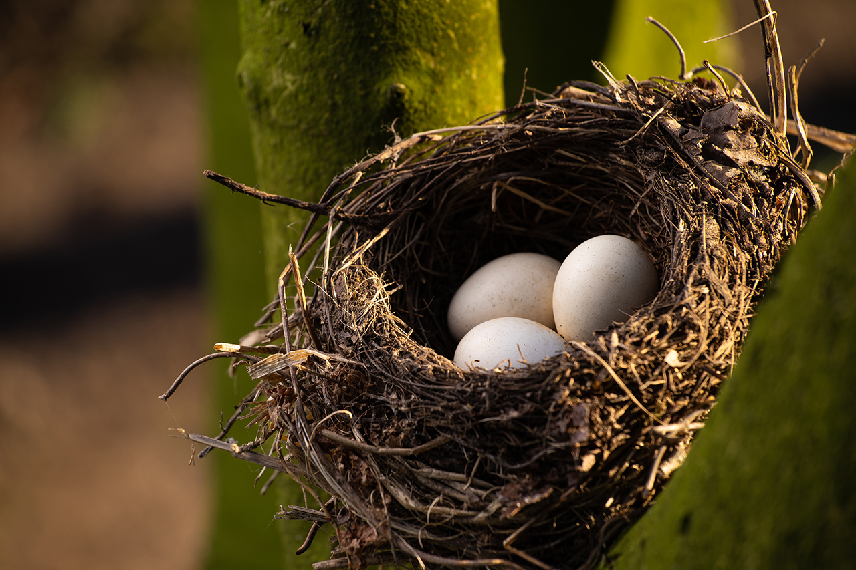
Summary and close
  Thanks to all for attending
  Record of voluntary actions to be taken by partners
  Next meeting for Fri 23rd October 2027 9.30am Rednock school
  climate@stroud.gov.uk

