Slide 1

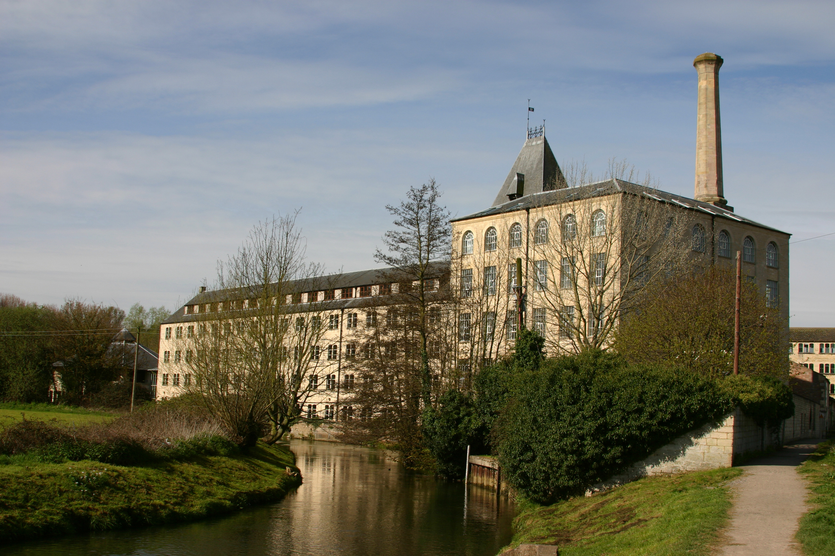


Developer Contributions
Thursday 26th February, 6pm

Slide 2

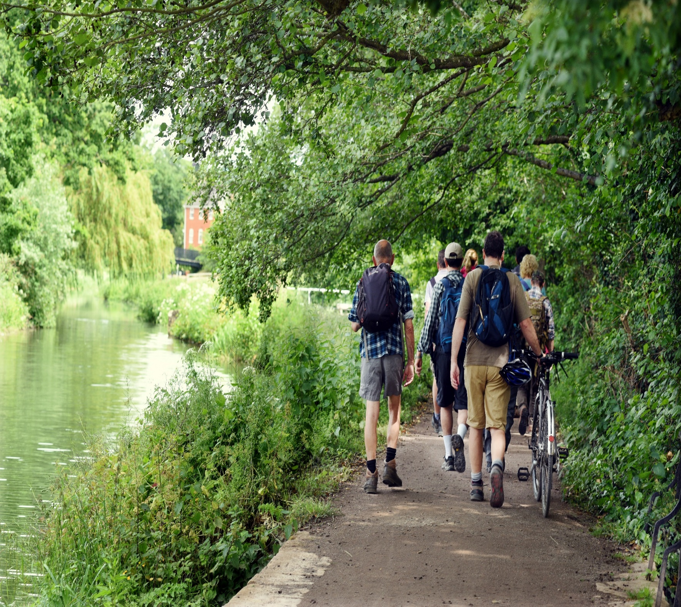

Introduction
In-kind and financial contributions are sought from developers to help provide for the infrastructure it will come to rely on and to help mitigate the impact of that new development.
In the Stroud District, there are two mechanisms in which this is done:
CIL (Community Infrastructure Levy)
S106 legal agreements

Slide 3

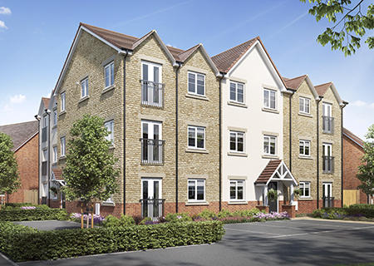
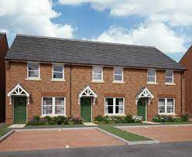
What is CIL?
  Community Infrastructure Levy (CIL)
  Adopted in April 2017
  Introduced by the Government to provide a fairer and more transparent system to S106 agreements.
  CIL liable development includes the creation of new dwellings, residential annexes and extensions and retail warehouses.
  All development is considered liable to a calculated CIL charge, unless it falls within the designated CIL Exemption Zone.
  Unless a site is an adopted strategic site in the adopted 2015 Local Plan

Slide 4
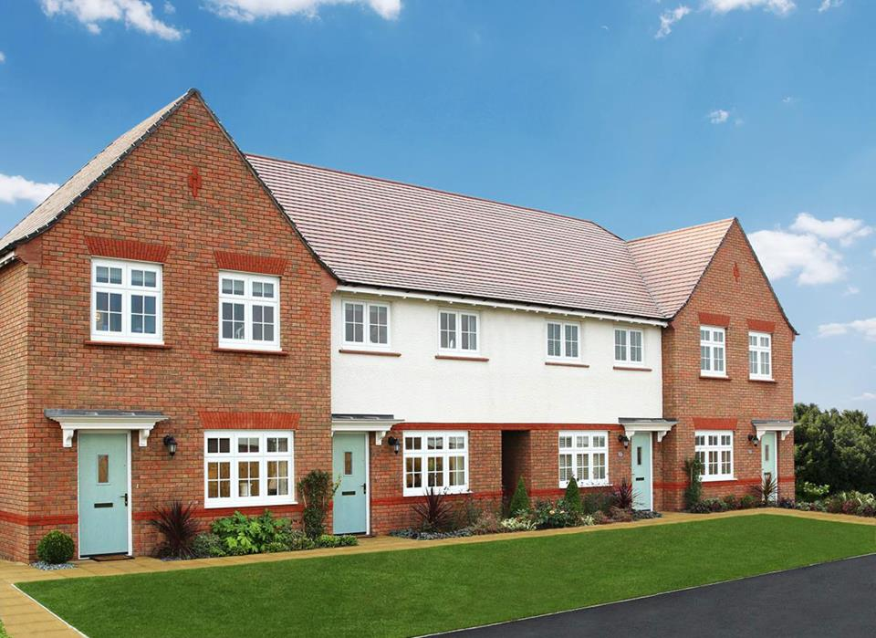

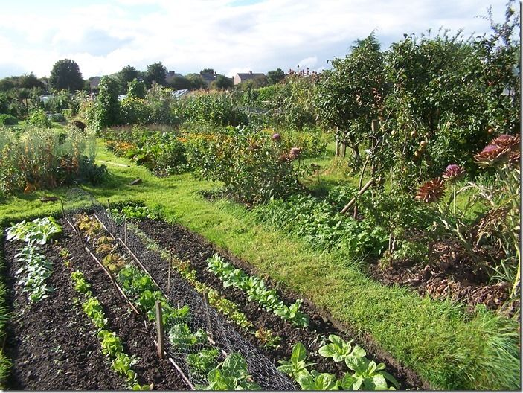
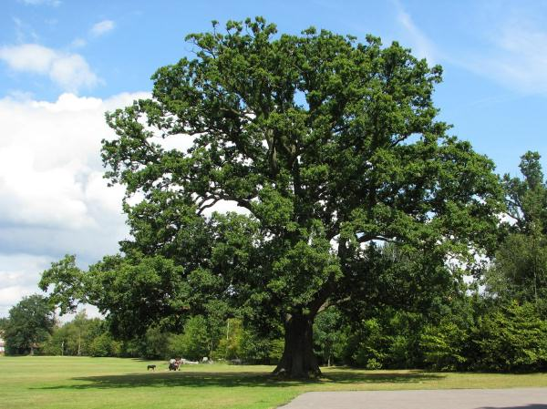
Section 106 Agreements
Legal Agreements with the developer to provide facilities or services that are necessary to make a development proposal acceptable in planning terms.
Site specific obligations are agreed with SDC and typically include:
  Affordable housing obligations (either on-site delivery or financial contributions)
  Public open space provision and
  Mitigation contributions for the Special Area of Conservation (SAC).
Highways, Education and Libraries contributions are secured and monitored separately by Gloucestershire County Council.

Slide 5

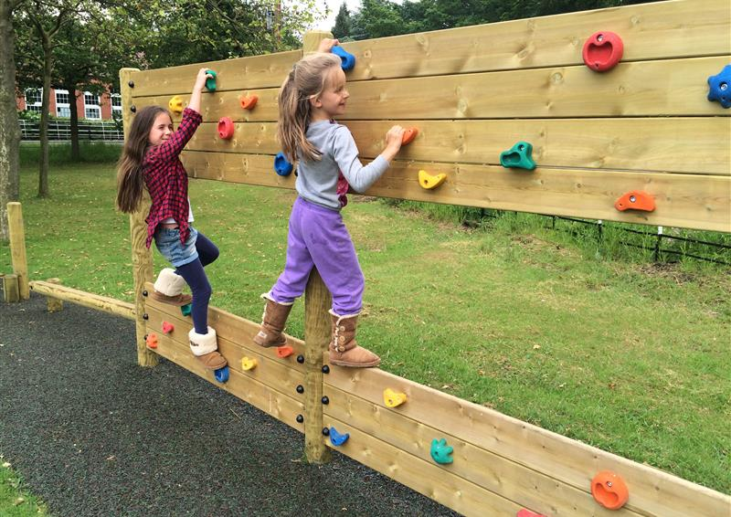
CIL Charging and Collection
CIL charge - determined and calculated by the creation of new residential floor area or from supermarkets or retail warehouses.
Approved drawings measured by the CIL team. Calculated using the new gross internal floor area (GIA); charged at a rated per square measure. The base rate is index-linked, so increases annually. The current residential CIL rate =
£115.94 per sqm.
SDC Instalment Policy = first instalment of 10% payable 60 days after commencement, with the remaining instalment schedule
over a period that depends on the total CIL charge.

Slide 6

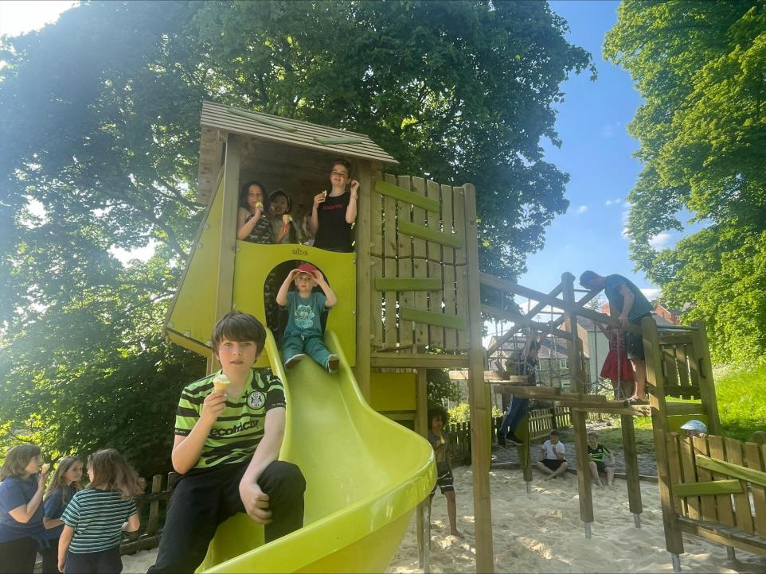
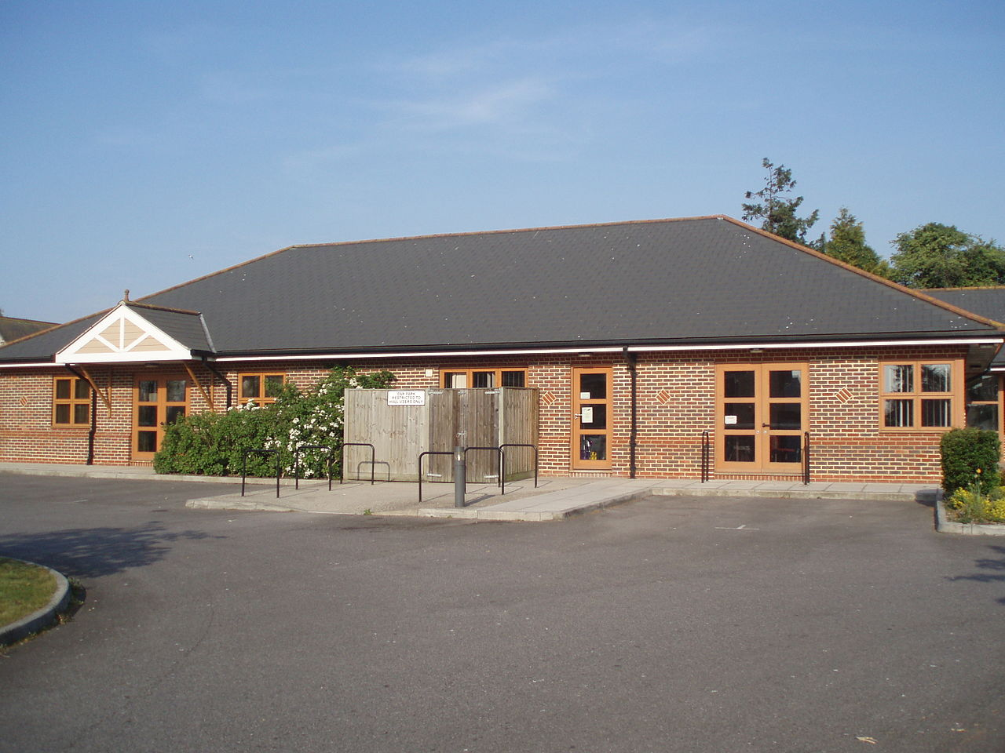

Spending CIL
Admin Portion - 5% of CIL collected is retained by SDC for administering the levy
CIL Neighbourhood Portion
25% if the area has an adopted Neighbourhood Development Plan
15% if the area does not have a Neighbourhood Development Plan
CIL Strategic Infrastructure Provision
Remaining % to the delivery of ‘big ticket’ infrastructure items. Delivering the growth objectives of the Local Plan, Infrastructure Delivery Plan (IDP) and Infrastructure Funding Statement (IFS)

Slide 7
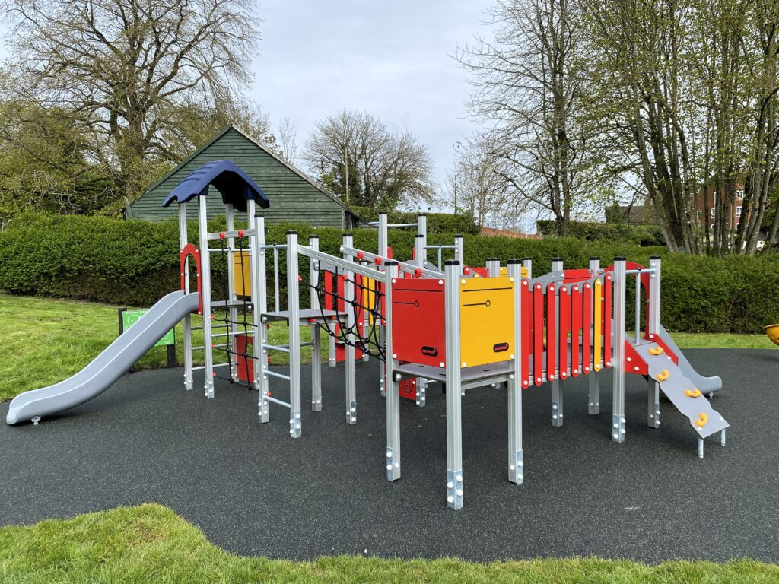
CIL Neighbourhood Portion
  SDC has collected £1.1m of Neighbourhood CIL since 2017.
  CIL NP is given from CIL collected from liable development within their area only.
  CIL NP is paid to Parish & Town Councils twice a year - April and October.
  5 years to spend – monitored through annual reports.
  Town & Parish Councils decide what their priorities are
  for spending CIL NP, no need for approval first!
  Must be spent appropriately on local infrastructure
  Can be used to match-fund larger Strategic Projects

Slide 8

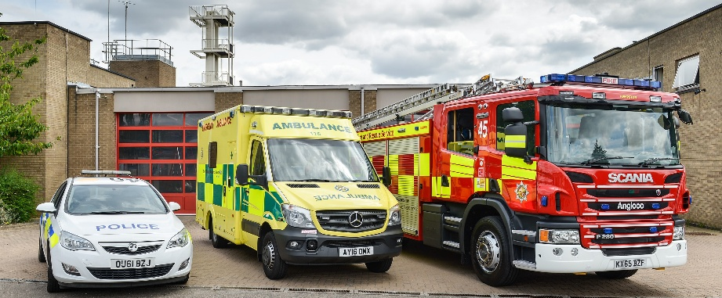
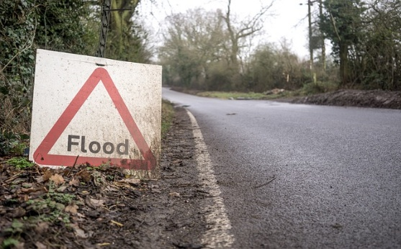
Strategic Infrastructure
  Annual Funding Scheme to support the growth objectives set out in the Local Plan, IDP and IFS.
  ‘Strategic’ - serves a much wider geographical area than the area in which the infrastructure is located
  Responds to the additional pressures created by new housing development.
  SDC has collected a total of £4.8m of Strategic CIL since 2017

Slide 9
Strategic Infrastructure
Annual project bidding process – opens April and closes mid- September each year.
Most Town and Parish Councils are not responsible for the delivery of ‘strategic infrastructure’ like schools or highways.
You can influence and support infrastructure provision by evidencing community priorities and working in partnership with larger organisations.
An ‘Eligibility Helpsheet’ is available on our website.

Slide 10
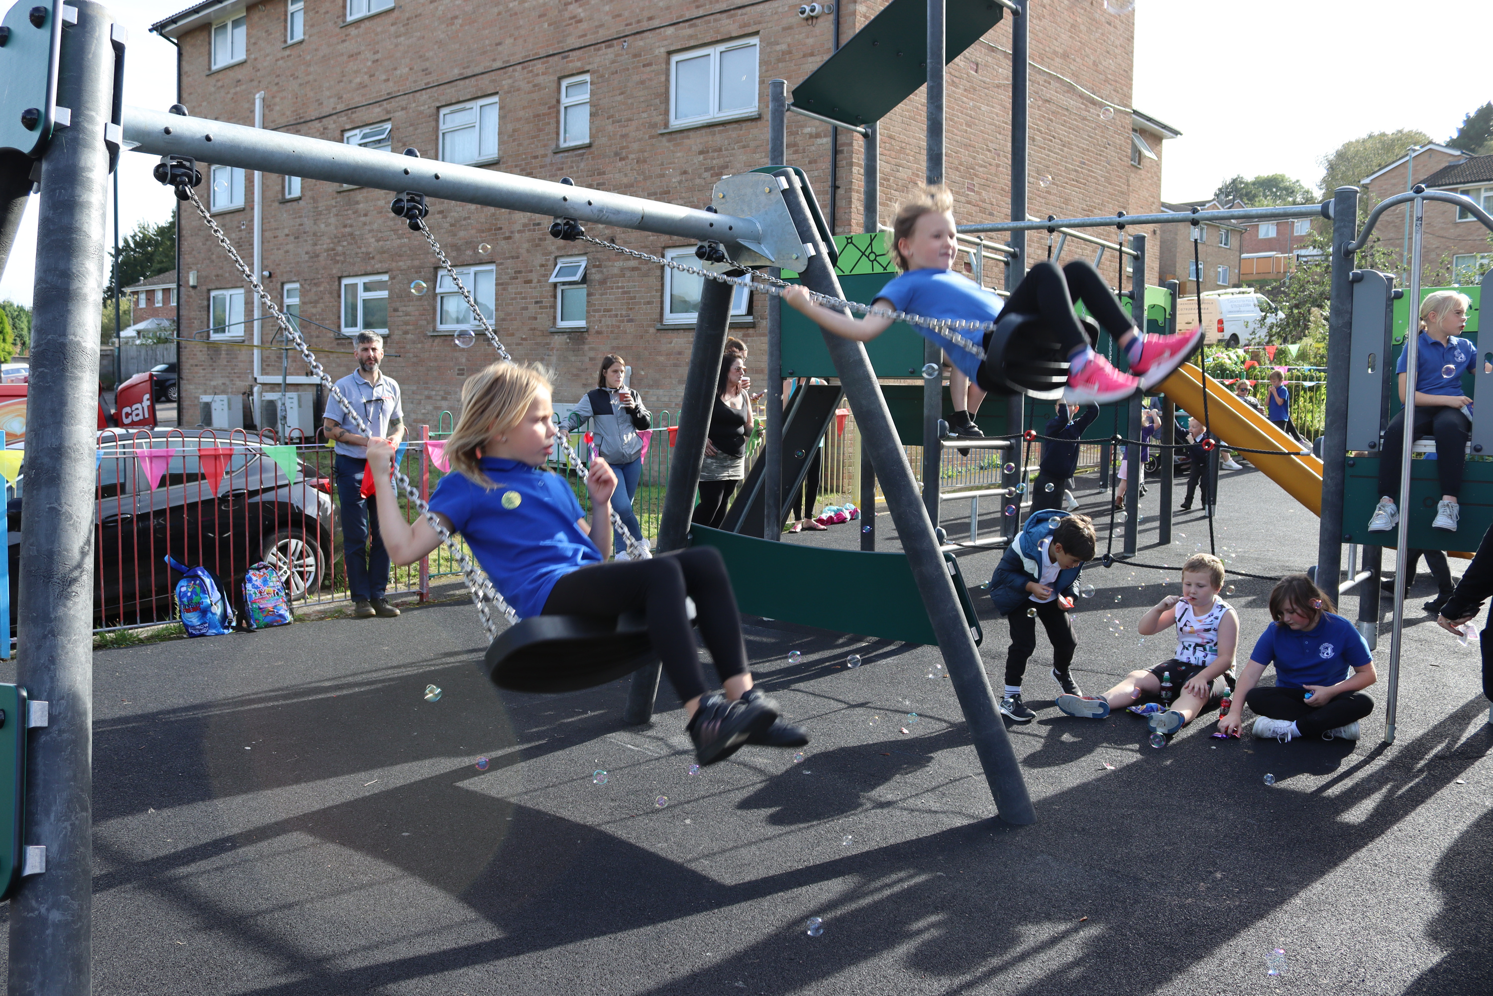




GET IN TOUCH
cil@stroud.gov.uk
Ebley Mill, Ebley Wharf, Stroud, GL5 4UB
01453 766321
www.stroud.gov.uk/CIL

